Slide 1

Welcome to Year 2 Family Learning!
The subject today is: Reading

Slide 2
Today we will talk about:
Importance of Reading
Reading in Year 2:
- Whole Class Reading
- Reading Comprehension and types of questioning

Slide 3

Why is Reading so important?

Slide 4
Reading in Year 2
Successful Decoding
Comprehension
Application
Whole Class Reading and Reading Comprehension Tasks

Slide 5
Whole Class Reading
Range of texts
Choral Reading
Echo Reading
Questioning

Slide 6

Reading Comprehension
Simple recall questions
Inference questions
Deduction questions

Slide 7
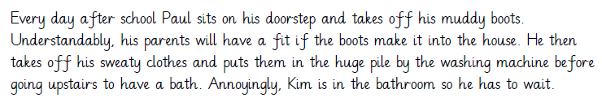
Examples of simple recall questions:
1. Where does Paul sit when he takes off his muddy boots?
2. What does Paul do after he puts his sweaty clothes by the washing machine?

Slide 8
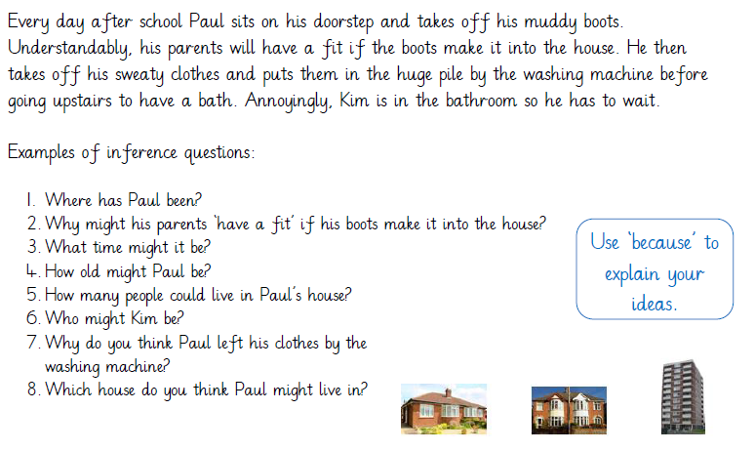

Slide 9
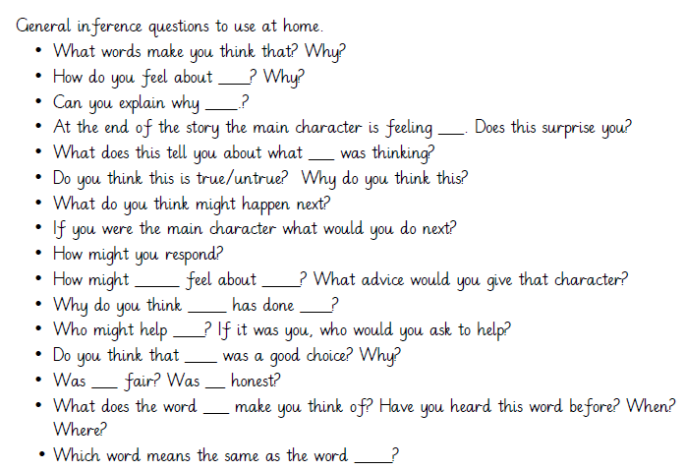

Slide 10
Activity 1 –
Whole Class Reading

Slide 11
Activity 1 – Whole Class Reading
Fred and the Ferocious Dragon
There once was a poor child called Fred who lived on the edge of a dark, damp forest.
Early one crisp, frosty morning, he woke up and was about to leave for school when his mother warned him… “Beware of the ferocious dragon in the cavernous cave!”
Not wanting to be late, Fred ran and he ran and he ran until he approached the cavernous cave. Were the rumours about the dragon true or was it just fantasy? Fred took a deep breath and peered cautiously inside.

Slide 12
Activity 2 –
Reading Comprehension

