Slide 1
Welcome to Year One Family Learning!
The subject today is: Mathematics

Slide 2
Today we will talk about:
A summary of topics that we will cover.
How do we approach Maths at Floreat ?
The current unit.
Family Learning activities.

Slide 3
What do we cover in Year One ?
In Year One we cover a wide range of topics. These include: Addition and subtraction to 20, multiplication and division, doubling and halving, time, measuring, money, fractions, capacity, mass, numbers to 40, numbers to 100 and shape and pattern.
On your seat is a copy of the yearly overview which may look familiar.

Slide 4
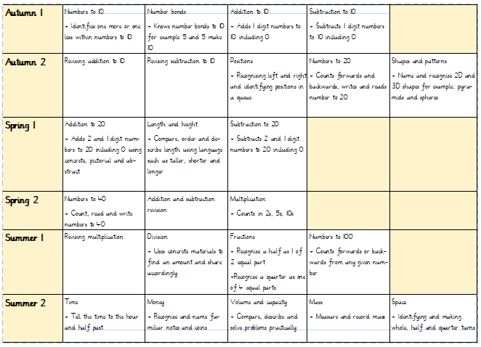

Slide 5
How do we approach Maths at Floreat ?
We use concrete, pictorial and abstract materials.
We use varying mathematical methods to support the children.
A scaffolding approach has proven very successful.
Practice, practice, practice!

Slide 6
The Current Unit
This term we have taught addition to 20 and measurement.
In order to ensure the children have an opportunity to digest these topics, we have sandwiched this term into the following:
Addition to 20 | Measurement | Subtraction to 20

Slide 7
Addition to 20
The children have been learning a new skill which is to add by making the ten and then counting on.
We have scaffolded the learning by providing concrete materials (cubes), moving on to solving pictures and finally: abstract.
This topic is fairly tricky to digest for most children which is why we feel they would further benefit from extra support at home.

Slide 8
How do we solve 7 + 5 using concrete ?
Concrete:
First make 7.
Then make 5.
Move cubes over from the five to make 10.
Now we have 10 + 2
The children automatically know that 10 + 2 = 12

Slide 9
How do we solve 7 + 5 using pictures ?
Pictorial:
10 + 2

Slide 10
How do we solve abstract?
Abstract (bridging through 10):
7 + 5 =
12
10
2
3

Slide 11
How do we solve abstract?
Abstract (numbers above 10):
4 + 12 =
16
6
2
10

Slide 12
Lets move through maths
Now we are going to move through a maths lesson.
We are going to start with concrete, then pictorial then abstract.
Your sheets are numbered 1, 2 and 3. Please follow them in order.
Next the children move at their own pace.
We will be around to support you with this.

