Slide 1
Year 6 Family Learning

Slide 3
What are the SATs?
SATs are the Standardised Assessment Tests that are given to children at the end of Key Stage 2.
The SATs take place over four days, starting on Monday 9th May ending on Thursday 12th May.
The SATs papers consist of:
Writing is assessed using evidence collected throughout Year 6. There is no Year 6 SATs writing test.
The key stage 2 tests will be taken on set dates unless your child is absent, in which case they may be able to take them up to 5 school days afterwards.
Monday | Tuesday | Wednesday | Thursday
GPS (45mins) Spelling (15mins) | Reading (60 mins) | Maths 1 (30 mins) Maths 2 (40 mins) | Maths 3 (40 mins)
Notes:
Note that there are no science assessments this academic year (including sampling tests).

Slide 4
When and how the SATs are completed
The tests take place during normal school hours, under exam conditions.
Each morning, the children will have a soft start to the day where breakfast will be provided.
Children are not allowed to talk to each other from the moment the assessments are handed out until they are collected at the end of the test.
After the tests are completed, the papers are sent away to be marked externally.
The results are then sent to the school in July.
Each test lasts no longer than 60 minutes:

Slide 5
The results
Tests are marked externally. Once marked, the tests will be given the following scores:
A raw score (total number of marks achieved for each paper);
A scaled score (see below);
A judgement on if the National Standard has been met.
After marking each test, the external marker will convert the raw score to a scaled score. Even though the tests are made to the same standard each year, the questions must be different. This means the difficulty of the tests may vary. Scaled scores ensures an accurate comparison of performance over time.
Scaled scores range from 80 to 120.
A scaled score of 100 or more shows the pupil is meeting the National Standard.
Notes:
There is no separate test that would indicate a pupil is working above the national standard.
A scaled score of less than 99 would indicate a pupil is working below the national standard.
To have a scaled score, pupils must have a minimum raw score (determined each year). If the pupil does not achieve the minimum raw score, they have not demonstrated sufficient understanding of the KS2 curriculum in the subject.

Slide 6
Spelling, Punctuation and Grammar: Monday 9th May
Spelling, Punctuation and Grammar consists of two papers.
Paper 1 focuses on all three elements (spelling, punctuation and grammar). The paper lasts for 45 minutes.
Paper 2 consists of a spelling test only. It should take approximately 15 minutes, although this is not a set amount of time (pupils should be given as much time as they need to complete the test).

Slide 7
Spelling, Punctuation and Grammar: Paper 1
This test focuses on:
Grammatical terms/ word classes;
Functions of sentences;
Combining words, phrases and clauses;
Verb forms, tenses and consistency;
Punctuation;
Vocabulary;
Standard English and formality.
This test requires a range of answer types but does not require longer formal answers.
Notes:
The question types include:
Circling
Drawing lines to connect
Multiple choice questions (including ticking tables)
One-word answers
Short answer questions

Slide 8
Reading: Tuesday 10th May
There is one reading test that lasts for 60 minutes.
The test is designed to measure if the children’s comprehension of age-appropriate reading material meets the national standard. There are three different set texts for children to read. These could be any combination of non-fiction, fiction and/ or poetry.
The test covers the following areas:
Give/ explain the meaning of words in context;
Retrieve and record information/ identify key details from fiction and non-fiction;
Summarise main ideas from more than one paragraph;
Make inferences from the text/ explain and justify inferences with evidence from the text;
Predict what might happen from details stated and implied;
Identify/ explain how information/ narrative content is related and contributes to meaning as a whole;
Identify/ explain how meaning is enhanced through choice of words and phrases;
Make comparisons within the text.

Slide 9
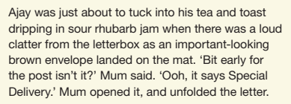
Reading
The reading SATs paper requires a range of answer styles.
Example questions:
Notes:
Question styles include:
Multiple choice questions
One-word answers
Short answer questions
Multiple mark (long answer) questions

Slide 10
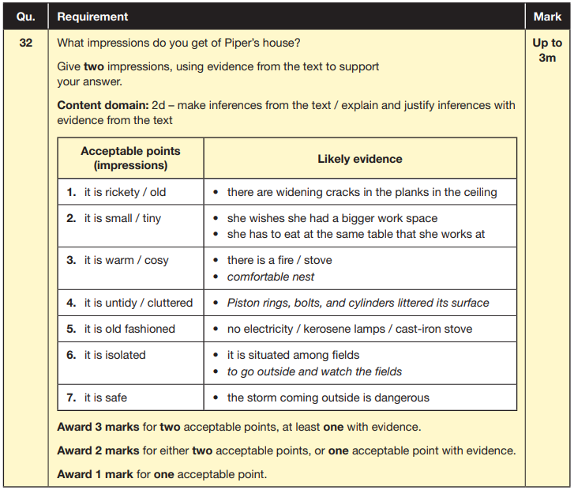
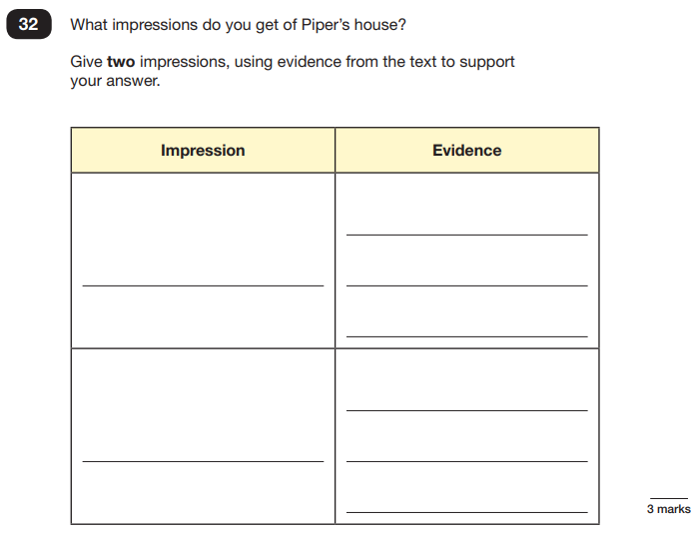
Reading
Example questions:
Based on text 3: Music Box
Notes:
This question is based on the whole text (2 pages).

Slide 11
Reading
Since the current testing formation for the SATs began in 2016, there has been a tendency for three types of questions to be the most popular.
In the 2019 Reading SATs paper,
12% of marks could be gained from answering questions involving giving and explaining the meaning of words in context;
42% of marks could be gained from answering questions involving retrieving and recording information or identifying key details from a text;
36% of marks could be gained from answering questions involving making inferences from a text and justifying inferences with text evidence.
When reading with your child at home try focusing on these types of questions.
Notes:
Example questions to ask at home:
What does this word mean?
Which word in this paragraph is the closest in meaning to…?
What [character] doing when [event] happened?
True or false questions about a paragraph/ text.
Why do you [character] did [event]? Can you think of another reason?

Slide 12
Maths: Wednesday 11th May and Thursday 12th May
The maths assessments consist of three tests.
Paper 1: Arithmetic (30 minutes) – Wednesday 11th May
Paper 2: Reasoning (40 minutes) – Wednesday 11th May
Paper 3: Reasoning (40 minutes) – Thursday 12th May

Slide 13
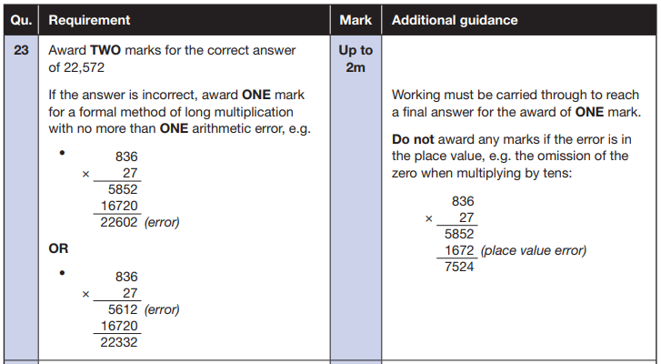
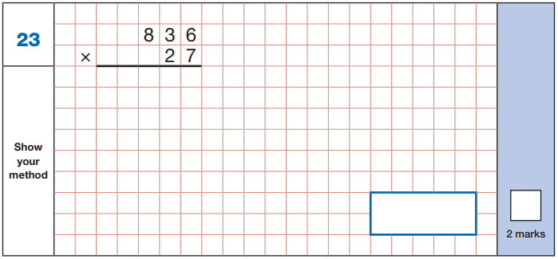
Maths Paper 1 (Arithmetic)
The maths arithmetic paper has a total of 40 marks.
The test covers the four operations (addition, subtraction, multiplication, division, including order of operations requiring BIDMAS), percentages of amounts and calculating with decimals and fractions.
Example question:
Notes:
Identify that there are some questions that have 2 marks and some that have 1. If the answer to this question is wrong, children could still get a mark for a correct method containing an error.

Slide 14
Maths Papers 2 and 3 (Reasoning)
Paper 2 will take place on Wednesday 11th May and paper 3 will take place on Thursday 12th May. These tests have a total of 35 marks each.
These papers require children to demonstrate their mathematical knowledge and skills, as well as their ability to solve problems and their mathematical reasoning. They cover a wide range of mathematical topics from key stage 2 including,
Number and place value (including Roman numerals);
The four operations;
Geometry (properties of shape, position and direction);
Statistics;
Measurement (length, perimeter, mass, volume, time, money);
Algebra;
Ratio and proportion;
Fractions, decimals and percentages.
Notes:
In general, the questions get progressively harder throughout the paper. As this is the case, it is not unusual for children to be unable to complete the entire paper in the given time. Maths Paper 1 (Arithmetic)

Slide 15
