Slide 1
YEAR 6 CAMP
Monday 16th May 2021- Wednesday 18th May 2022

Slide 2
What is it?
Year 6 will be taking part in a 2 night/3 day residential trip at Marchants Hill, Surrey.
It includes full board accommodation, adventure activities, evening entertainment and plenty of fun!
Pupils will be joined by Miss Weeks, Miss Mcleod, Ms Burke and two other members of staff.
Pupils will return on Wednesday and will be expected to attend school on Thursday and Friday where we will continue with an activity based week.

Slide 3
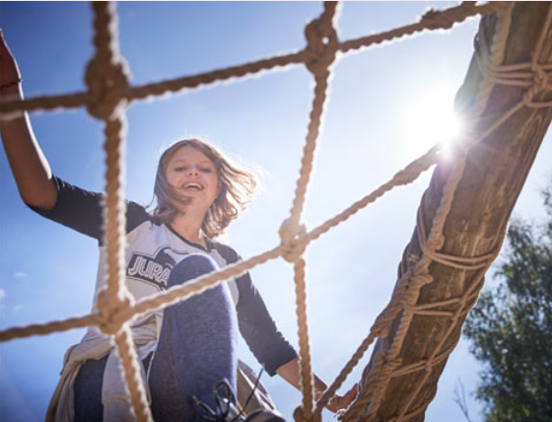
Why PGL?
Leadership, teamwork, communication and problem solving are all key skills that pupils will develop and make progress with on a PGL multi-activity course.
Overcoming new challenges with the support of their peers, teachers and PGL staff helps to develop character, resilience, self-confidence and independence.
The outdoors environment provides many opportunities for pupils to work closely together and will help improve their social awareness.
Reaching goals as a team means pupils are able to recognise the achievements of others as well as their own.
Development of many personal qualities such as self-reliance, responsibility, initiative and perseverance.

Slide 4
How much will it be?
The trip, including transport, accommodation, food and all activities will be £280 per child.
A deposit of £20 is required by October 22nd to secure your child’s place.
PGL Camp has been added to ParentPay.
Full payment will be required by 22nd April.
If you have any concerns about paying for the residential trip please do speak with Mr Custance.

Slide 5
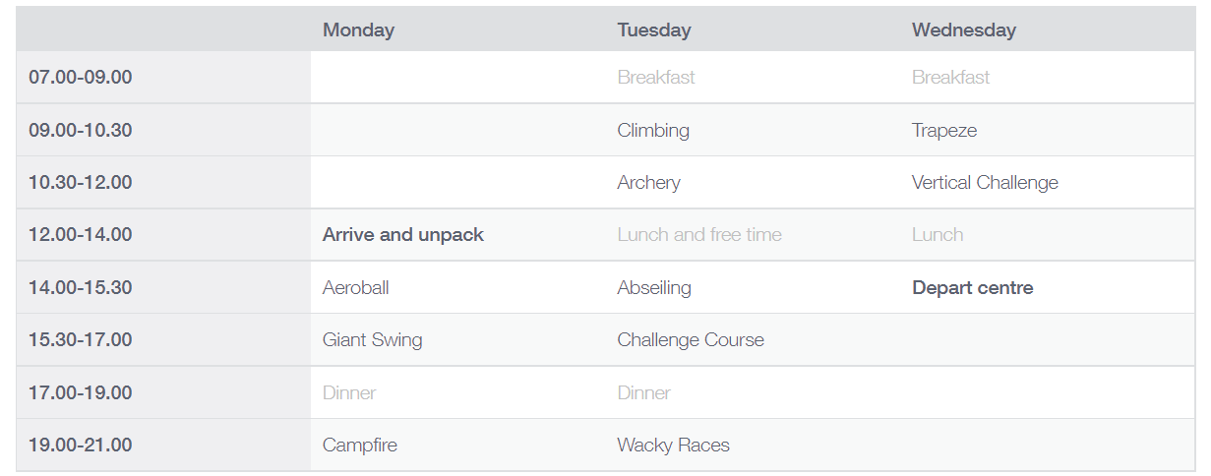
A typical itinerary at PGL

Slide 6
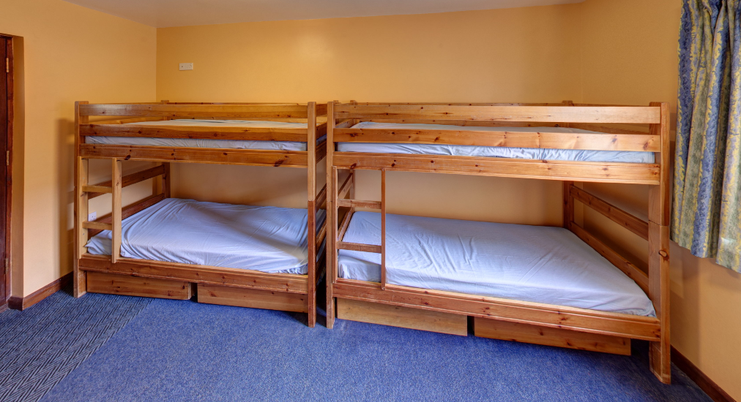
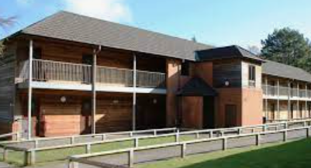
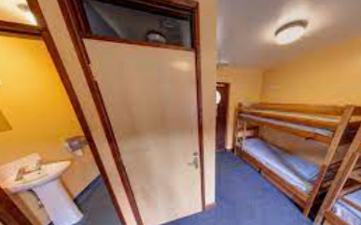
Accommodation
We will be staying in lodges on site at Marchants Hill.
Pupils will have ensuite rooms which can sleep up to 6.
Rooms are lockable and there is a Night Security Patrol.
Staff will also be staying on site.
Children will be able to suggest names of who they would like to share a room with and adults within Year 6 will make the final decision taking their wishes into account. This will happen closer to the time.

Slide 7
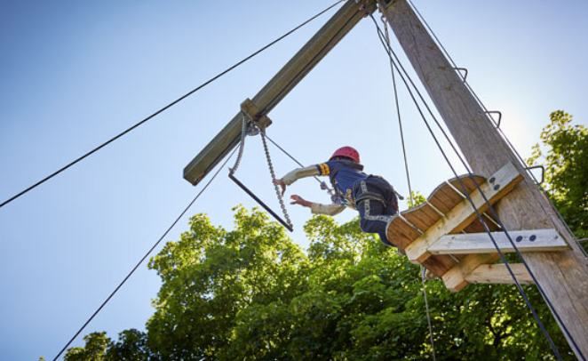
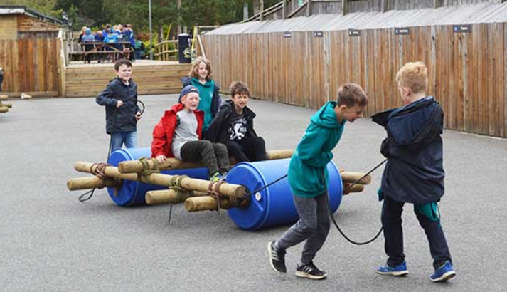
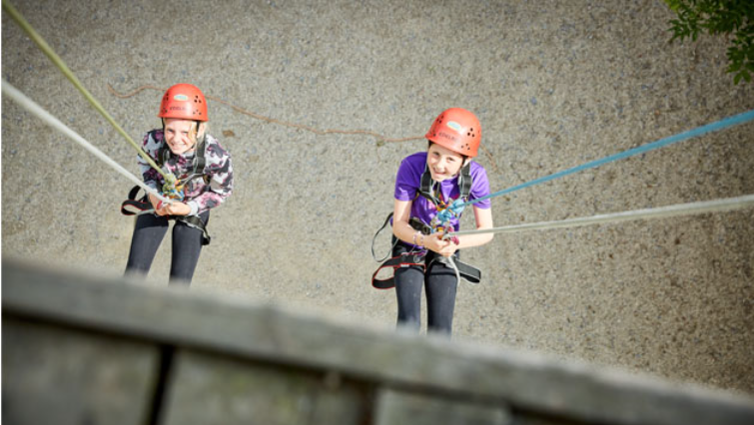
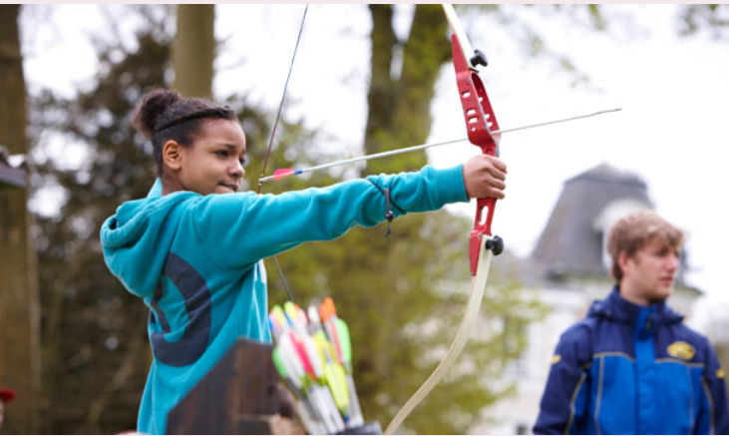
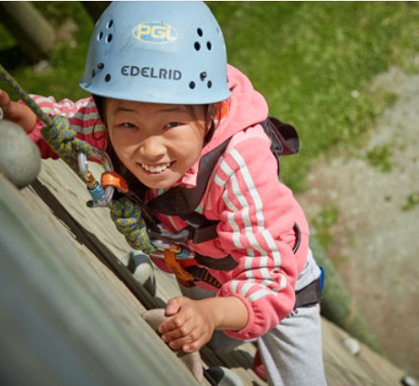
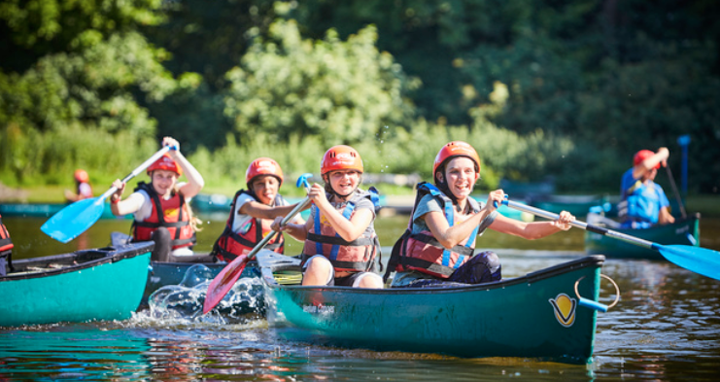
Activities
There are four 90 minute sessions each day and a huge variety of outdoor activities to choose from.
Our activities will be selected and confirmed in January.

Slide 8
Safety
All PGL's adventure activities take place under the instruction and guidance of specially trained PGL instructors who prioritise safety above all else.
Activities take place on land, on the water and in the air (for our rope-based challenges), so each brings a different (and fun!) way for children to challenge themselves in a friendly, safe and supportive environment.
All staff are specially trained and have a vast experience of running primary school residential camps.

Slide 9
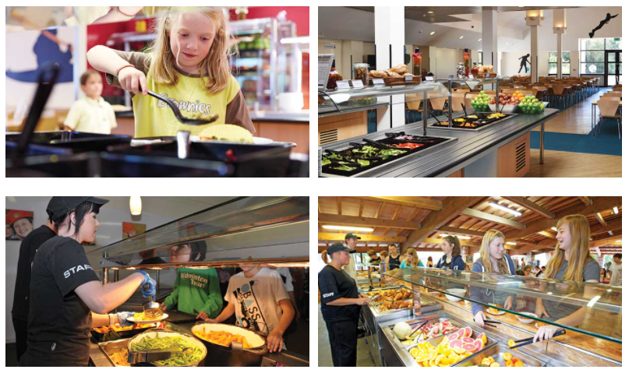
Food
There are freshly-prepared hot or cold options available at every mealtime and a self-service salad bar for children to help themselves to as much salad as they like at lunch and dinner. Homemade soup is available most days and there is plenty of bread and fresh fruit available, as well as hot and cold drinks.

Slide 10
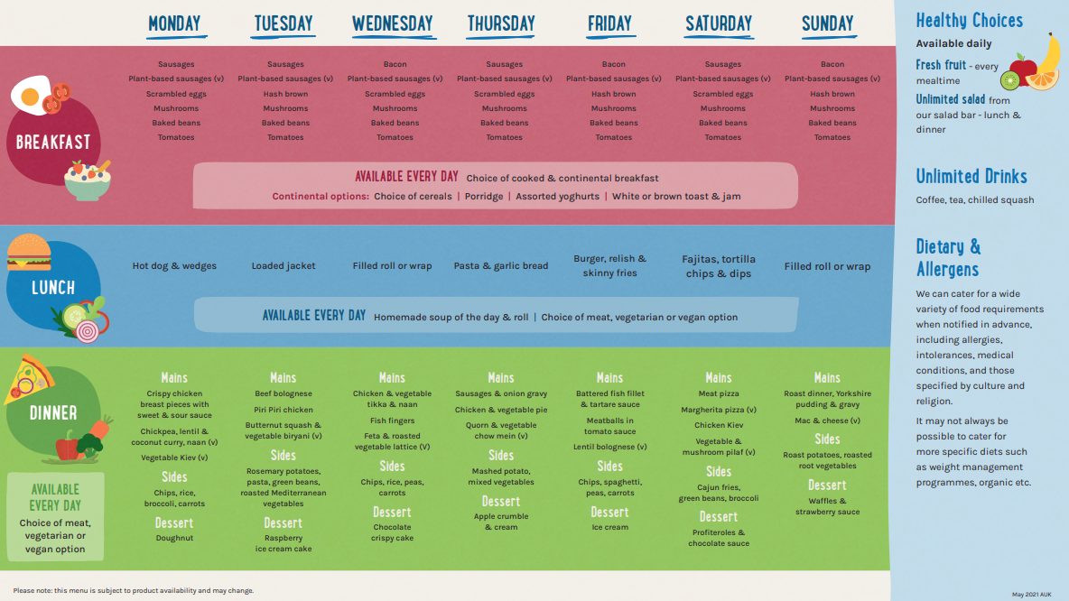
Food

Slide 11
What will my child need? A more detailed list will be provided closer to the time
Old clothes – they will be doing lots of physical activities so old clothes are best.
2 pairs of trainers – including an old pair for any water based activities.
‘dry’ shoes for evening activities.
2 towels – one for showering and one for activites.
Sleeping bag or duvet and pillow.
Children will not need mobile phones, electronic devices or any valuables.

Slide 12
Contact
Floreat Staff will be in regular contact with the school and Mr Custance.
Photo updates will be posted regularly on the school Twitter account (@FloreatWands).
We will continue to use the same system as when children are in school if we need to make contact with you.
Contact the office with any general queries and they will contact us if needed.

