Slide 1
Year 5 Family Learning

Slide 2
Spanish

Slide 3
Aims
Overview of self-regulation
To understand how ‘The Zones of Regulation’ works
Self-regulation tools
Calming techniques
Thinking strategies
Sensory supports

Slide 4
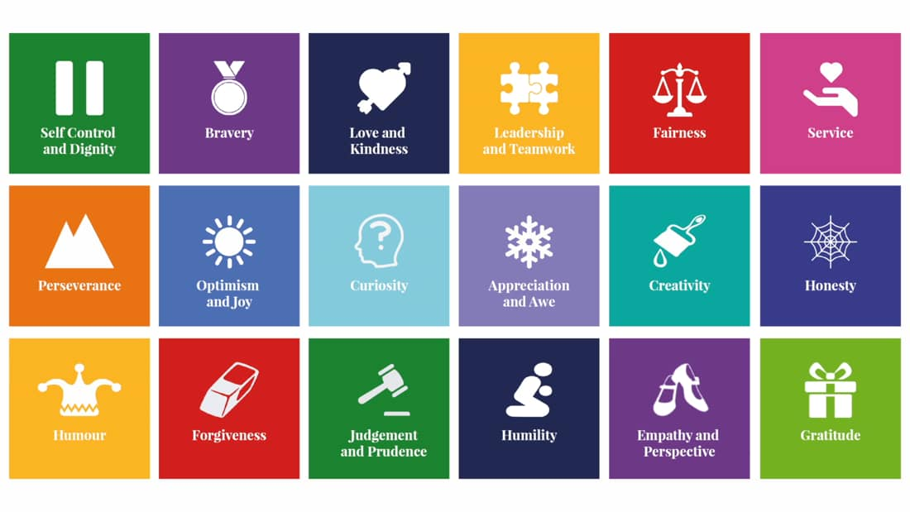
How many character virtues can you name?

Slide 5
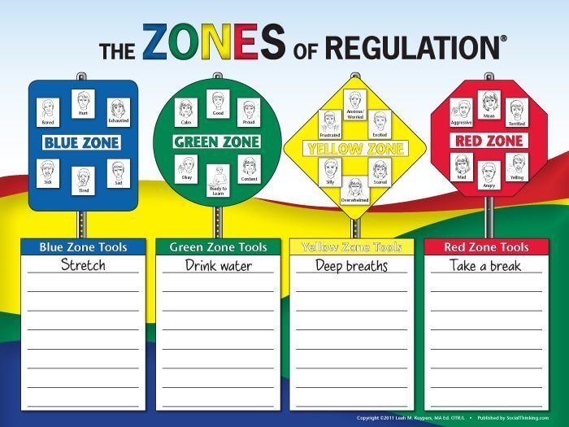
Supporting Behavioural Regulation

Slide 6
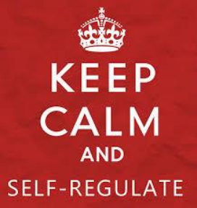
Definition of Self-Regulation
“…it is defined as the capacity to manage one’s thoughts, feelings and actions in adaptive and flexible ways across a range of contexts.”
Jude Nicholas
This includes:
Self-control
Resilience
Self-management
Anger management
Impulse control
Sensory regulation

Slide 7
Why is Self-Regulation Important?
Life is 10% what happens to us and 90% how we react to it.
Charles Swindoll
Research has found that higher academic achievement is more likely when interventions include self-regulation components.
Typically, children who can self-regulate will turn into teens who can self-regulate.

Slide 8
A person who can self-regulate is able to:
Remain CALM AND ORGANISED in a stressful situation
(Executive Functions)
Cheer themselves up after a disappointment.
(Emotional Regulation)
Knows when they are experiencing sensory overload and can make adjustments.
(Sensory processing)
Understands when it is appropriate to cheer and shout and when to be quiet.
(Social cognition)

Slide 9
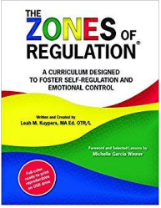
What are the Zones of Regulation?
Teaches students:
Vocabulary of emotional terms
How to recognise their own emotions
How to detect the emotions of others (read others’ facial expressions)
What may trigger certain emotions
How others may interpret their behaviour
Problem solving skills

Slide 10
Why Teach the Zones of Regulation?
Provides a common language to discuss emotions – a language that is non-judgemental.
The Zones of Regulation is simple for children to understand but is helpful for all!
The Zones teach healthy coping and regulation strategies.

Slide 11
Blue Zone: sad, sick, tired or bored (low state of alertness – brain and/or body is moving slowly or sluggishly).
Green Zone: in control, calm, happy and ready to learn (regulated state of alertness).
Yellow Zone: more intense emotions and states but able to maintain control, worried, frustrated, silly, excited, scared or overwhelmed (heightened state of alertness but you still have some control).
Red Zone: elated, angry, wild, terrified. (heightened state of alertness and out of control).

Slide 12
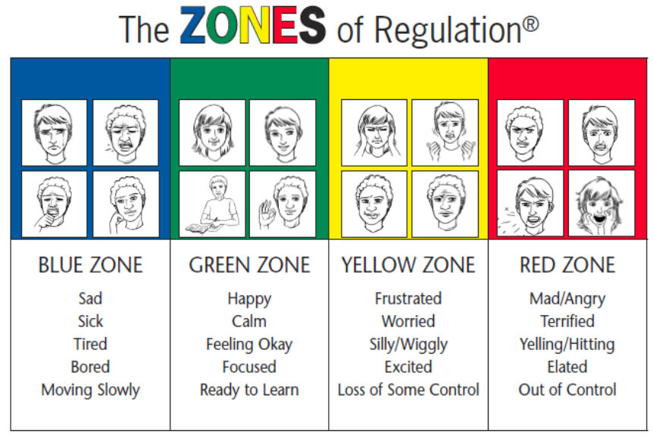

Slide 13
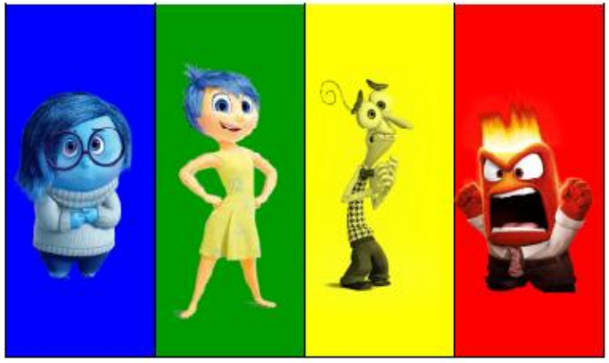

Slide 14
Key Points
There is no ‘bad’ Zone.
Everyone experiences all of the Zones at different times and in different circumstances.
We can’t change the way children feel BUT we can help them manage their feelings/states and behaviours. “It’s OK to be angry, but it is not OK to hit…”
You can be in more than one Zone at a time (eg. Sad and angry).

Slide 15
Key Points
If your child is confidently using words to describe their emotions, they don’t need to revert to Zones language HOWEVER it is useful for them to know the strategy groups that will help them.
Eg. Sick or tired = blue zone strategies
If your child is in the Red Zone…
Limit verbals – this is not a teachable moment.
Discuss use of tools when child is regulated.
Plan for if/when child is in the Red Zone. “Wonder if this strategy would help…?”

Slide 16
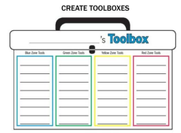
UNDERSTANDING ZONE TOOLS:
Blue Zone: help wake up our bodies, feel better and regain focus.
Green Zone: help us stay calm, focused and feeling good. These are often proactive strategies.
Yellow Zone: help us regain control and calm ourselves.
Red Zone: help us stay safe and start to calm down.

Slide 17
TOOLS FOR SELF-REGULATION
Thinking Strategies
Sensory Supports
Calming Techniques

Slide 18
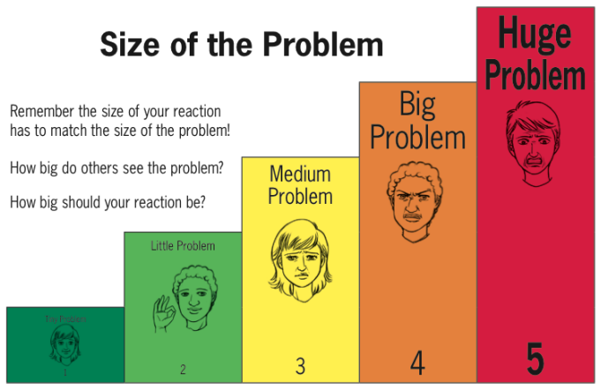
THINKING STRATEGIES
Expected vs. Unexpected Reactions – Praising the expected, not just pointing out the unexpected.

Slide 19
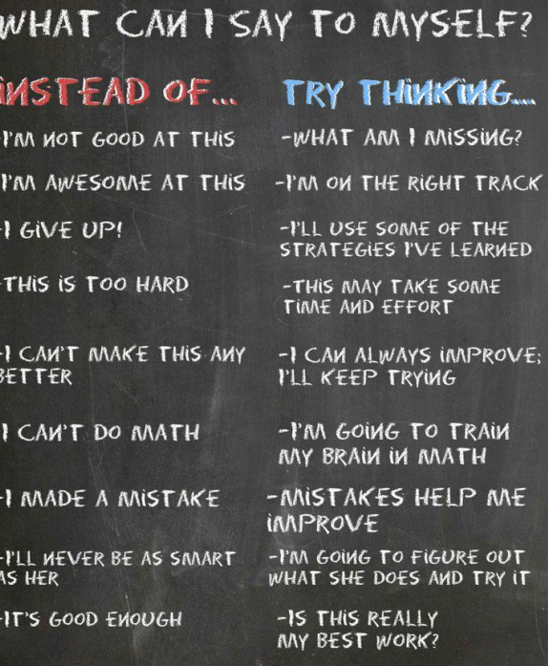
INNER COACH vs. INNER CRITIC

Slide 20
SENSORY STRATEGIES:
Wobble board to sit on.
Go for a walk.
Wall push ups.
Blowing bubbles.
Sitting on hands.
Stretch.
Stress balls.
Slime.
Timers.
THESE ARE NOT A TREAT BUT A TOOL TO HELP THE CHILDREN FEEL REGULATED.

Slide 21
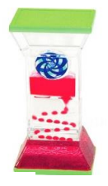
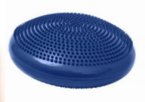
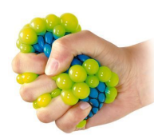
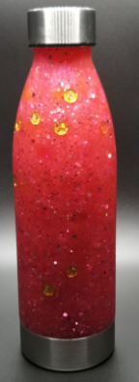
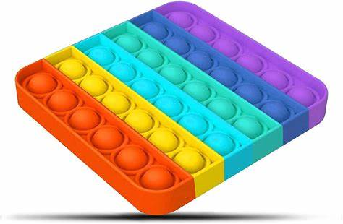
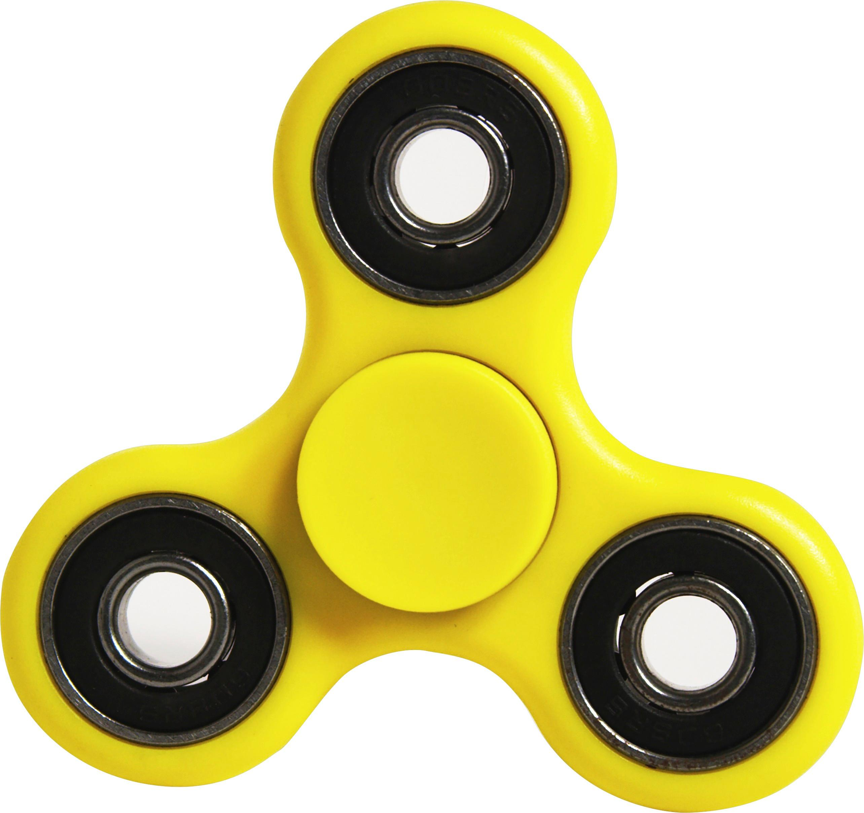
SENSORY TOOLS

Slide 22
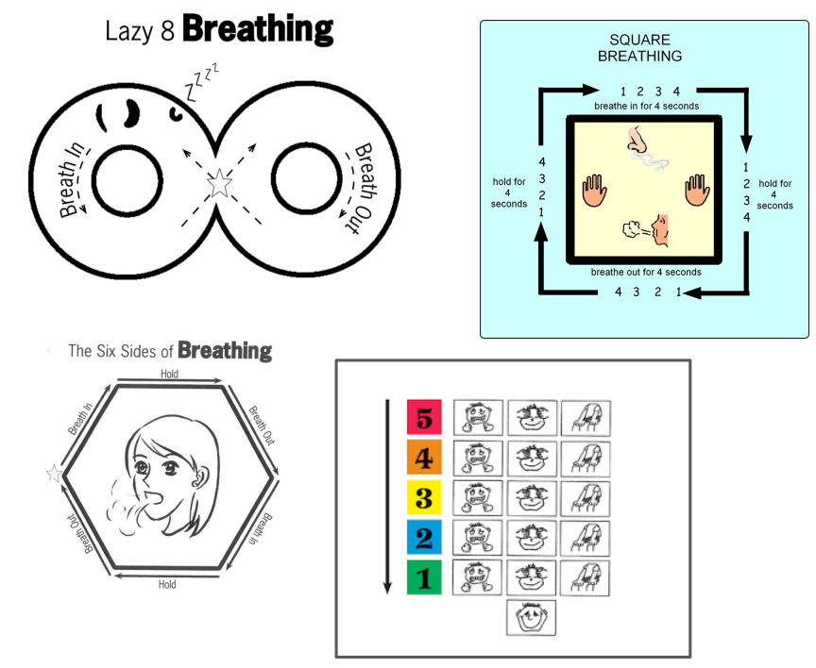
CALMING STRATEGIES

Slide 23
COUNTING
Forward and backwards
Count objects
Count colours
Count breaths
Count pulse

Slide 24
CALMING ACTIVITIES
Puzzles
Listening to Music
Draw/Paint
Origami
Play-Doh/clay
Read
Stack Rocks

Slide 25
HOW CAN I SUPPORT THE ZONES OF REGULATION?
Identify your own feelings using Zones language in front of your child. (e.g. “I’m frustrated, I am in the yellow zone”)
Provide positive reinforcement when your child is in the Green Zone and if they make efforts to stay in the Green Zone. (e.g. “I can see you are working really hard to stay in the Green Zone by…”)
Talk about what tool you will use to be in the appropriate Zone. (e.g. “I’m going to go for a walk, I need to get to the green zone.”)
Label what zones your child is in throughout the day. (e.g. “You look sleepy, are you in the blue zone?”)
Teach your child which Zones tools they can use. (e.g. “It’s time for bed, let’s read a book together in the rocking chair to get to the blue zone.”)
Post and reference the Zones visuals and tools in your home. (Zone check in stations and toolboxes for the family!)

Slide 26
PLAY GAMES
“Feelings Charades”
“Name that feeling”
Books
A Volcano in My Tummy
The Red Beast
Conker the chameleon

Slide 27
MORE INFORMATION ON THE ZONES
Zones of Regulation Website
Pinterest

Slide 28
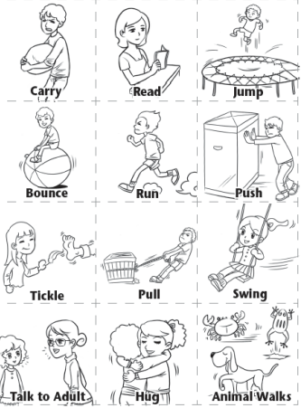
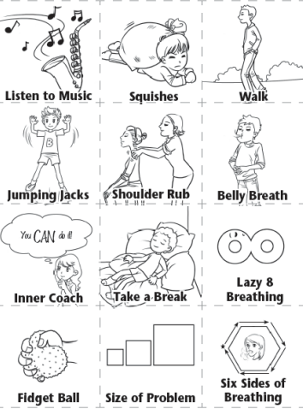
WHICH STRATEGIES CAN I USE FOR EACH ZONE? Can you think of any others?

Slide 29
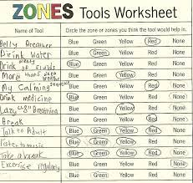
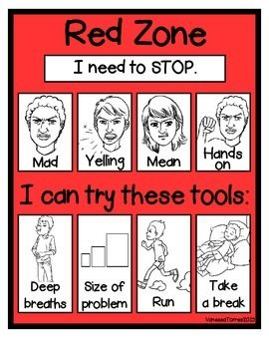
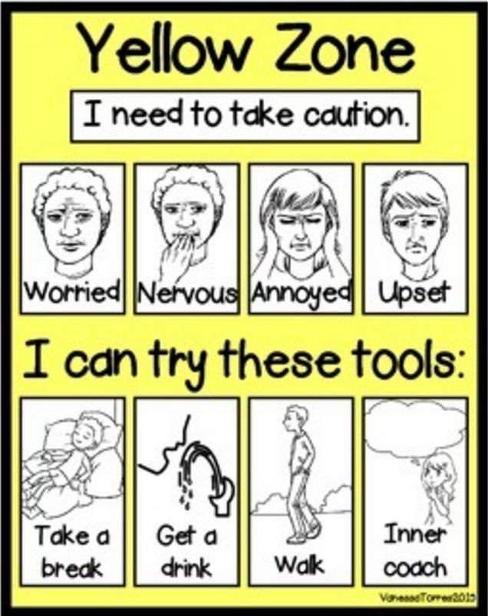
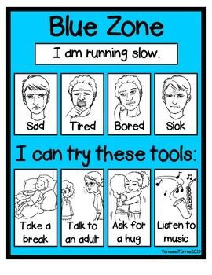
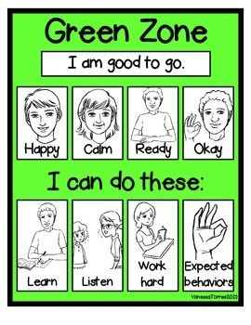
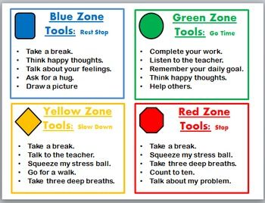

Slide 30
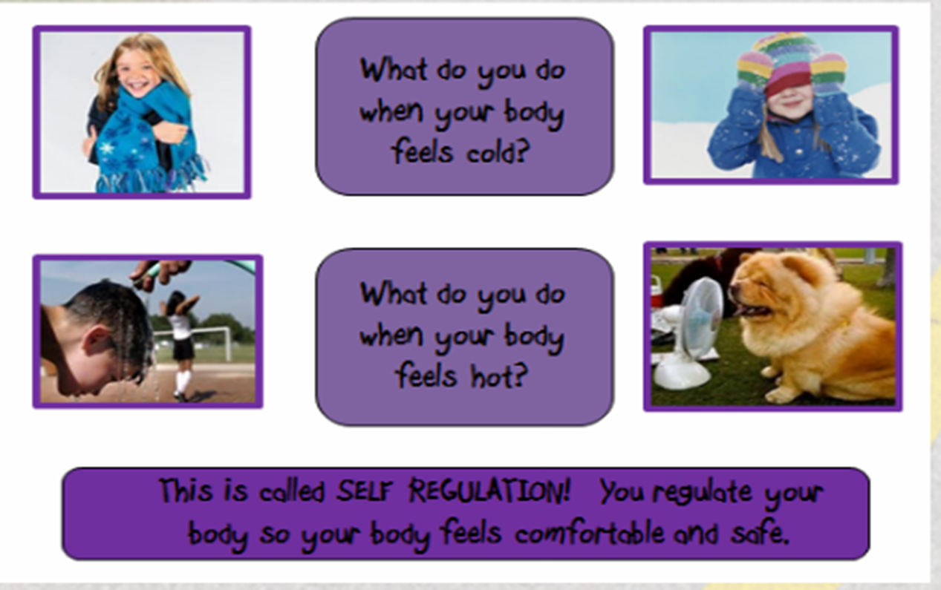
What is self regulation?
The ability to focus your attention, control your emotions and manage your thinking, behavior and feelings.

Slide 31
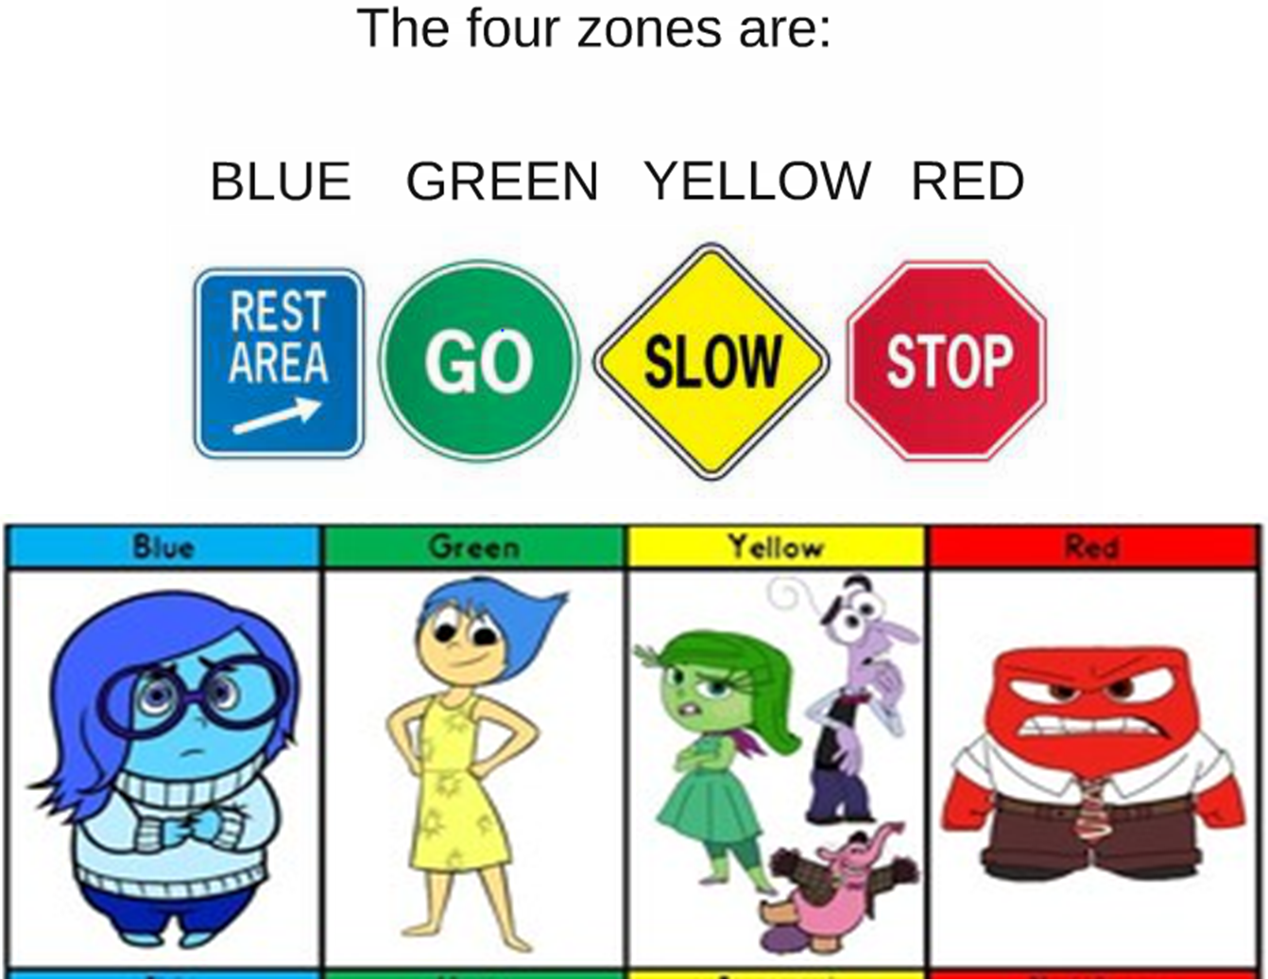
Achieving self-regulation
The first step is identifying how your body and brain feels.
There are four zones that help us with this.

Slide 33
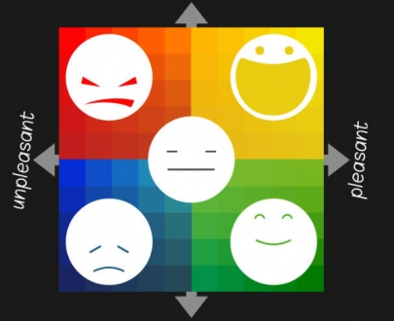

Slide 34
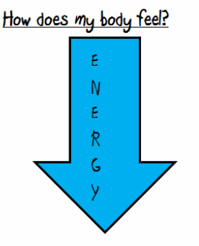
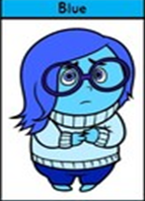
Blue Zone
We are expected to be in the Blue Zone just before bedtime or when watching TV.
We have less energy and it doesn’t feel pleasant.
This is an unexpected zone to be in for learning.

Slide 35
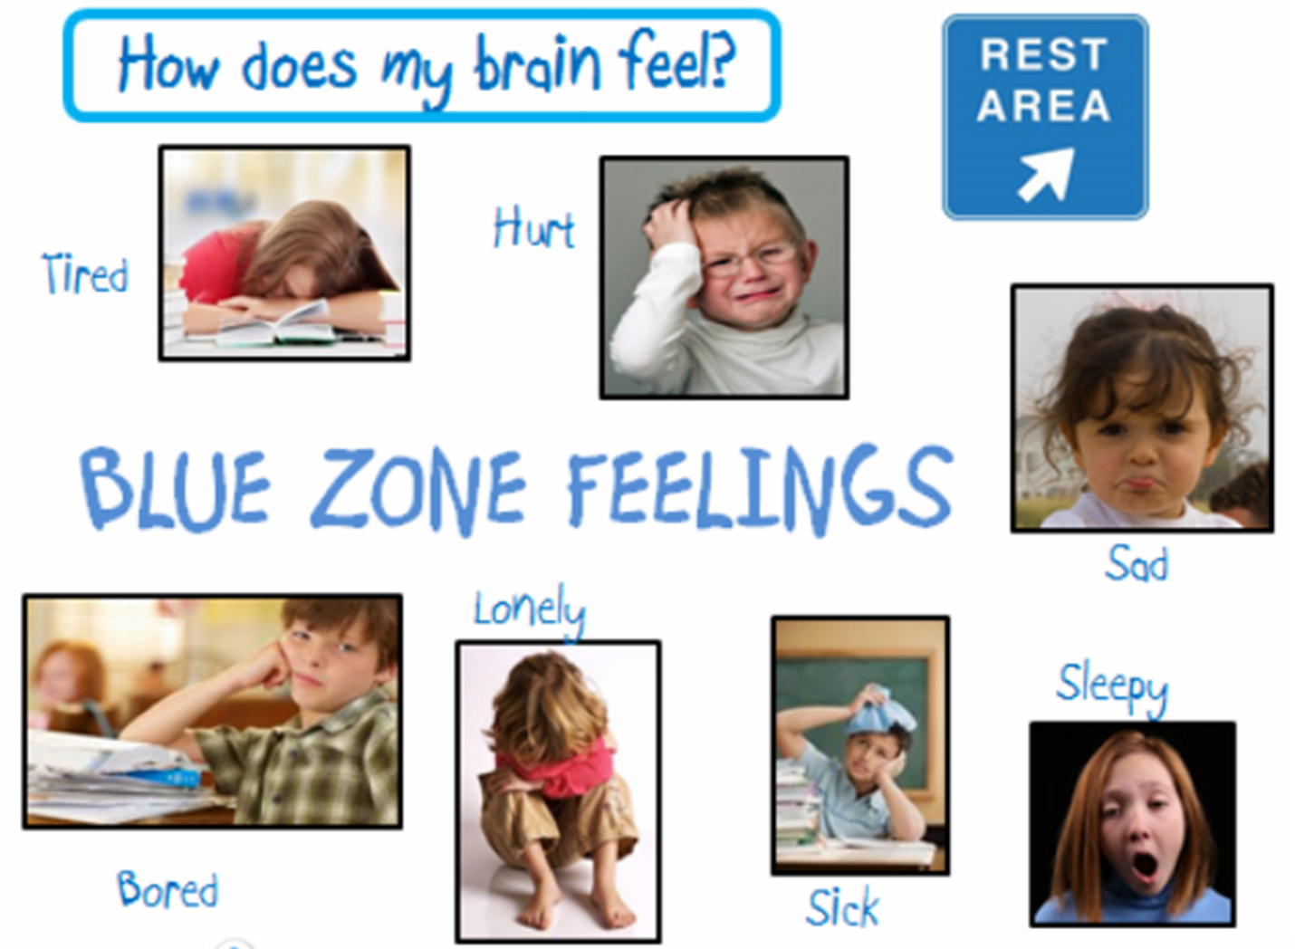

Slide 36
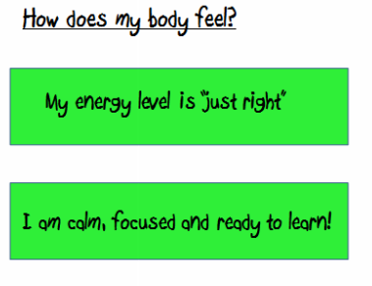
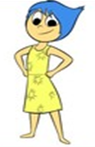
The Green Zone
This is the Learning Zone.
We are expected to be in the Green Zone while we are learning.
This is when our brains and bodies are relaxed and focused.

Slide 37
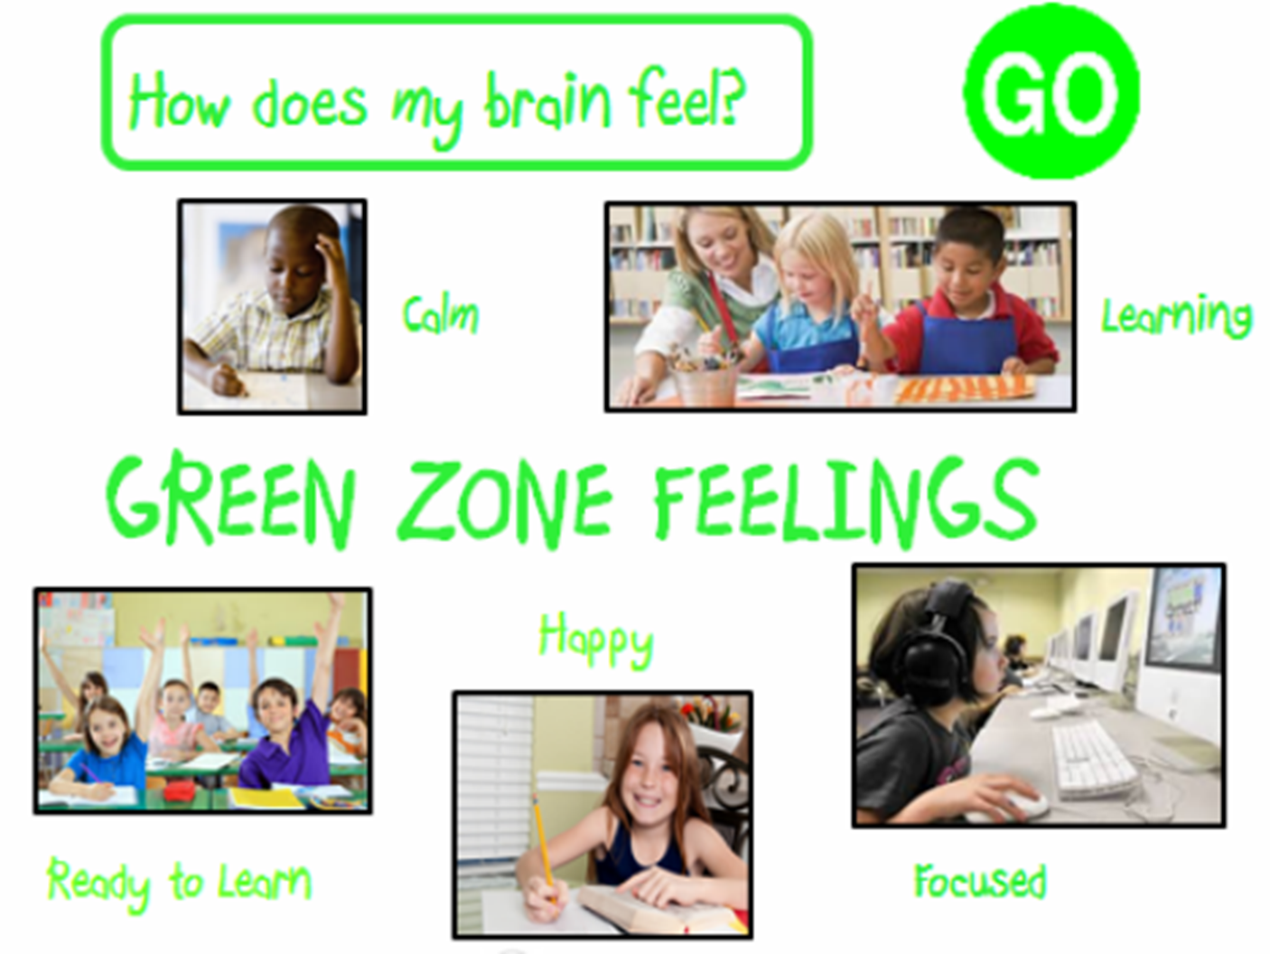

Slide 38
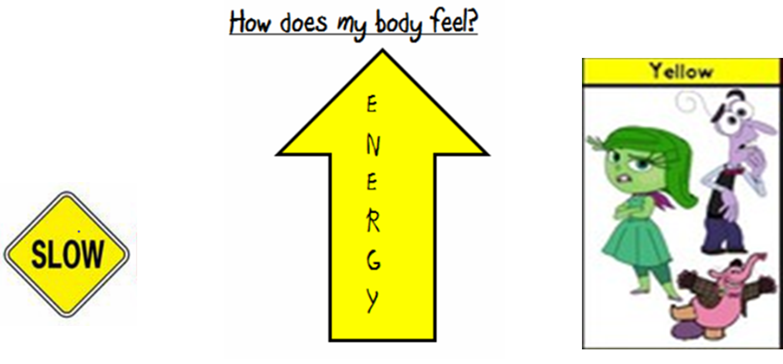
The Yellow Zone
This is the expected zone during playtime or lunchtime or the end of the day.
This is when we have lots of excited energy.

Slide 39
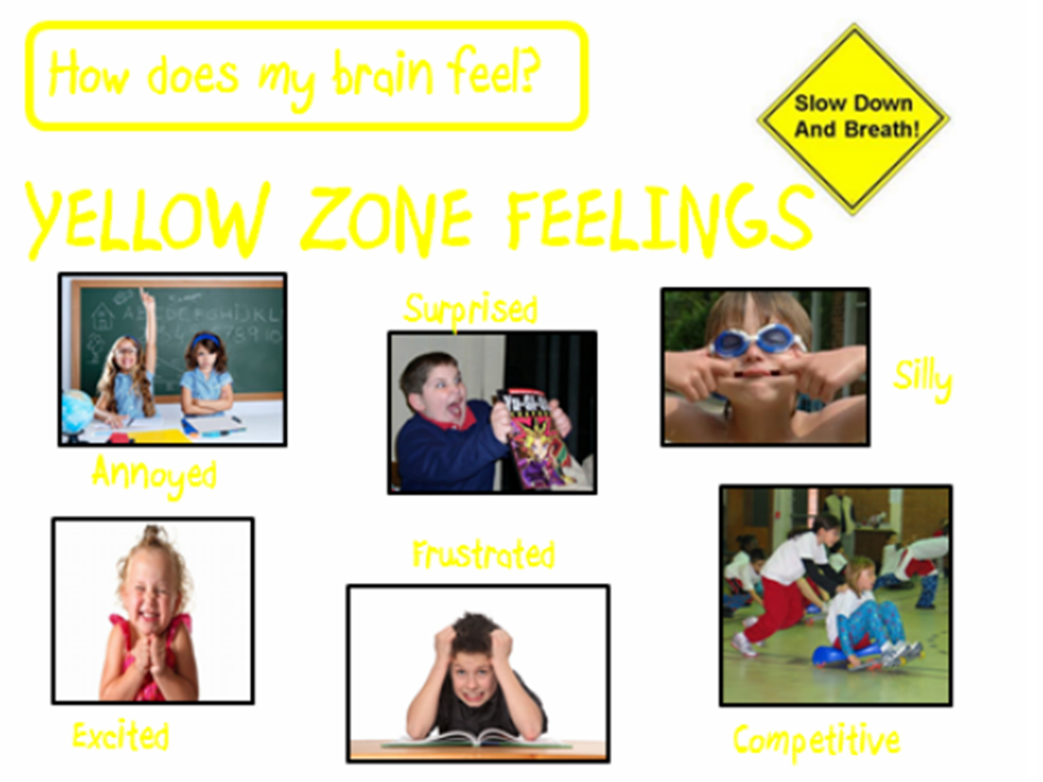

Slide 40
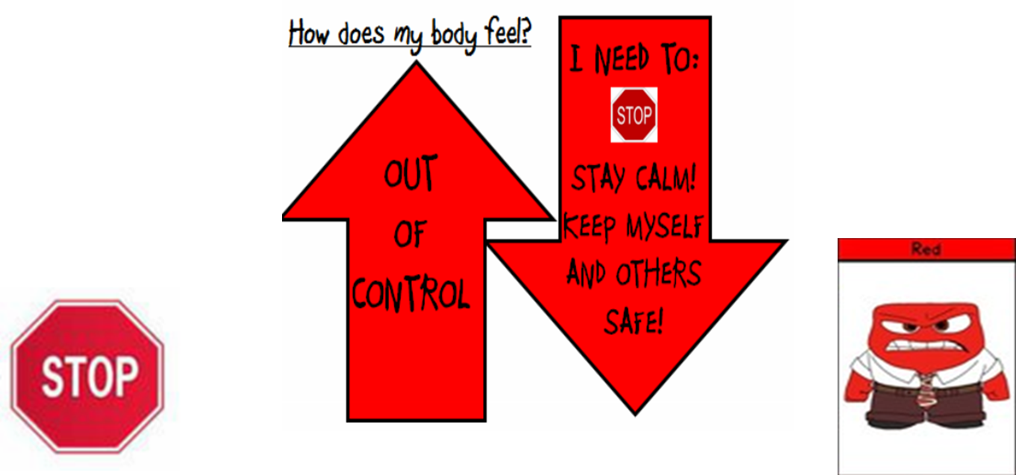
The Red Zone
When we are at school, the red zone is unexpected.
It is important that at school we keep ourselves and others safe.

Slide 41
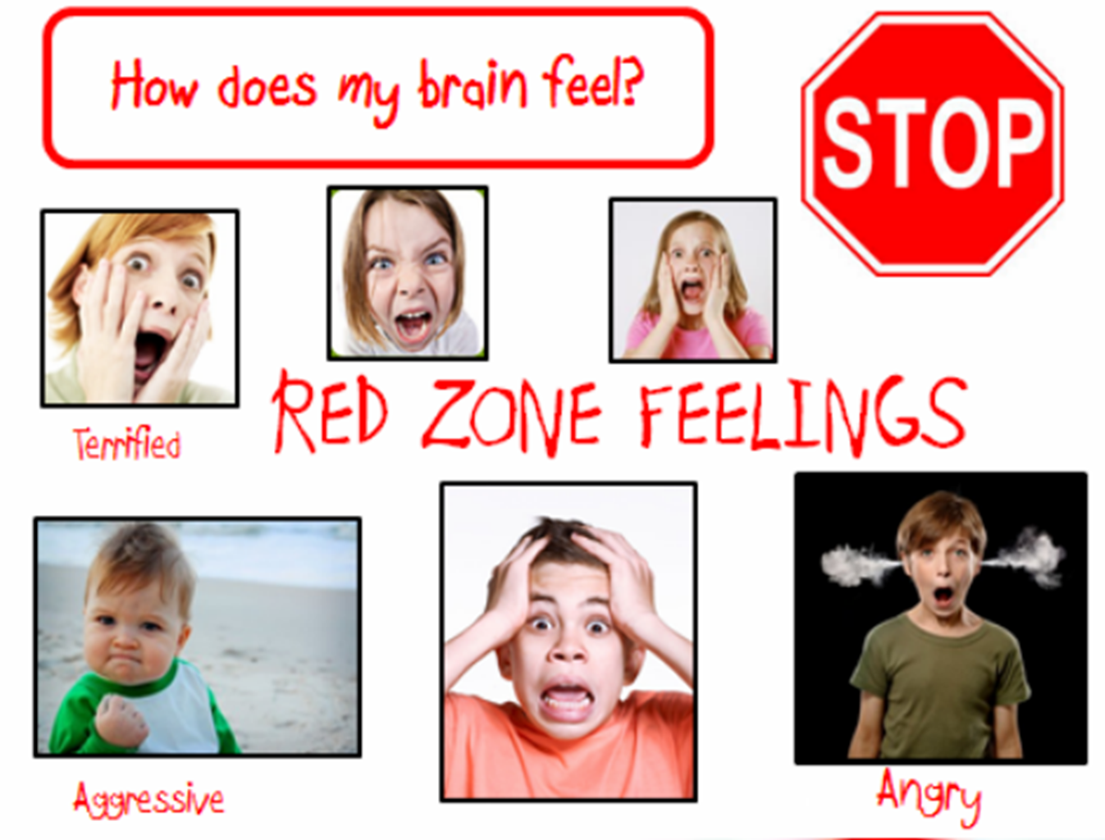

Slide 42
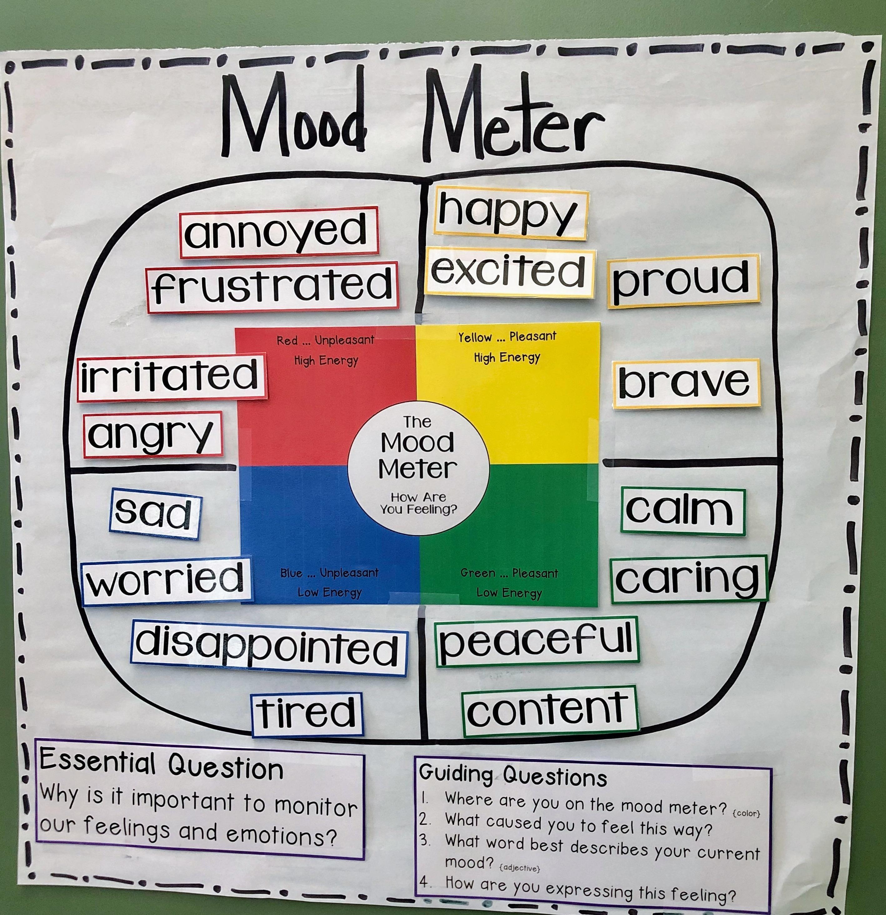

Slide 43
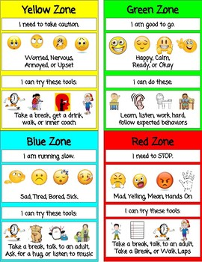
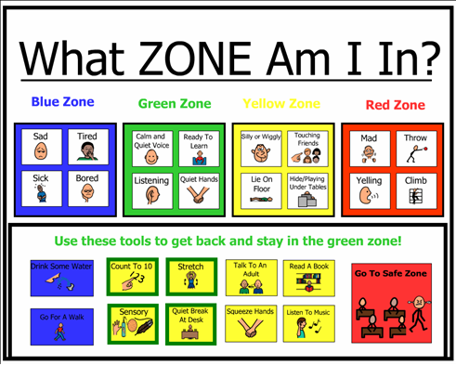

Slide 44
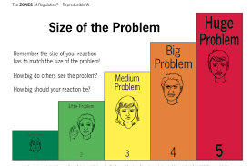
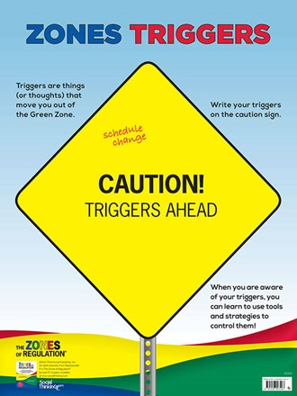
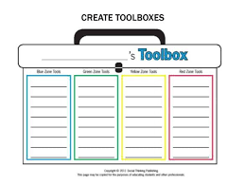

Slide 45
Zones of Regulation
This is a matter of priority, especially within Upper Key Stage 2.
The language of Zones of Regulation, encouraging children to reflect upon their emotions and how they could make positive steps to change them needs to be embedded within your classroom.
Zones of Regulation work does not need to be formally recorded in a book, but a simple folder can be kept for each child for them to refer back to and reflect upon.
Displays around the classroom should serve as visible reminders for children to identify their zone and know how they can alter this.

