Slide 1
Family Learning
Monday 11th October 2021

Slide 2
Sounds-Write
Sounds-Write is a quality first phonics programme.
Its purpose is to provide classroom professionals with a comprehensive system with which to teach reading, spelling and writing.
In addition, it also serves very successfully as an intervention or catch-up programme.
Comprehension skills

Slide 3
Segmenting/Spelling
Segmenting | Helps to spell
Blending | Develops independency for reading
train

Slide 4
Why is it important?
Strong readers
Confident writers
Independent learners

Slide 5
Phonics Screening Test
Government requirement - every Year 2 child in the UK will be taking part
40 words – 20 real, 20 fake
Autumn term – should have happened in Year 1
Pass mark around 32 – subject to change
Orange juice and KitKat

Slide 6
Phonics Screening Test

Slide 7
Activity time!
1) Sound Swap | 2) Find the digraph/trigraph
3) Series of words – syllable chopping | 4) Paragraph – find the split digraph

Slide 8
Activity time!

Slide 9
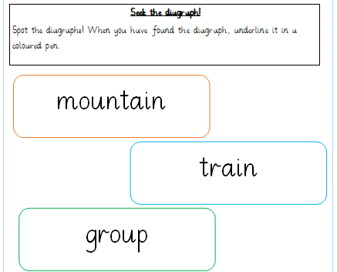
Activity time!

Slide 10
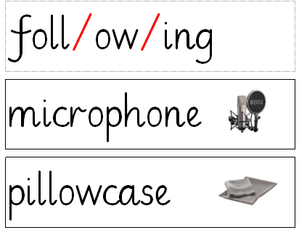
Activity time!

Slide 11
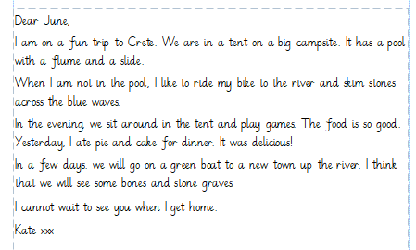
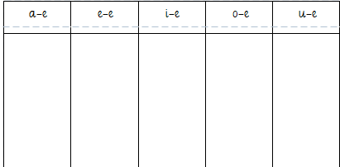
Activity time!

Slide 12
Activity time!
Let’s welcome our children.

