Slide 1
Welcome to Year 1’s Family Learning!
Our focus today will be on Phonics

Slide 2
What is Sounds Write?
Sounds Write is a scheme to teach children how to read and write successfully.
Your children have been immersed in this way of learning since nursery.
The children now know all of their single letter sounds e.g. a, b, c, d
They also know all double consonants e.g. ll, ff, tt

Slide 3
Blending and segmenting
Blending is a skill that pushes the sounds together to build a word and this skill tends to be used more in reading. To support the children with this we would say: “Say the sounds and read the word”.
Segmenting is the ability to pull sounds apart and this skill tends to be used more in writing. “What is the first sound you can hear in the word ____”.

Slide 4
Building on this learning all children are now working on recognising 2 letters that represent 1 sound e.g. e, ea, ee, y
tree messy be
When supporting your child to select the correct representation it is important that we do not say it’s the a e spelling as this reminds them of their root sound.

Slide 5
Same sound different spelling
Moving forward the children are soon going to be learning that one spelling can represent more than one sound. E.g. ea, ea
great speak
If a child reads a word by pronouncing the incorrect sound firstly ask them if they know any other sounds this digraph can represent. If this doesn’t work we say ‘In this word, this (points to digraph, represents ……)

Slide 6
This is how we teach the different representations of a sound

Slide 7
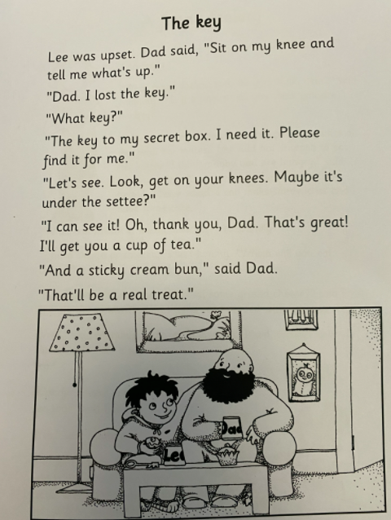
Seek the sound
ee | ea | ey | e
Word | Sound
Lee | ee

Slide 8
Sentence Dictation

Slide 9
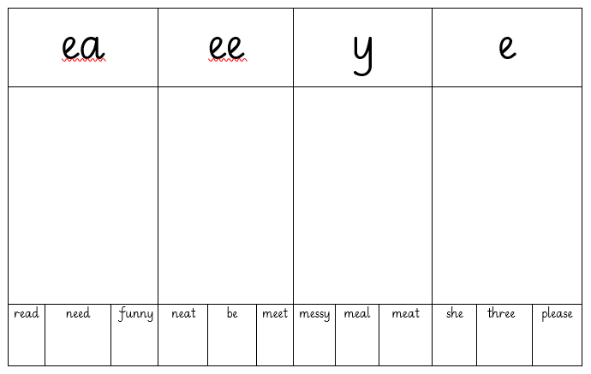
Sound Grid

Slide 11
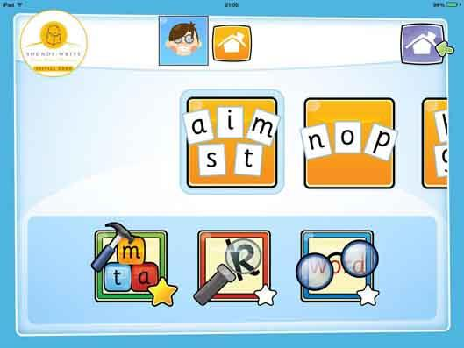
How we teach phonics and useful links
https://www.udemy.com/course/help-your-child-to-read-and-write/ Udemy SoundsWrite Course
SoundsWrite App

