Slide 1
Sounds Write
What does a child need to know:
Letters are symbols that represent sounds.
A sound can be spelled by 1,2,3 or 4 letters.
dog street night dough
-The same sound can be spelled in different ways.
rain break gate

Slide 2
Skills
Blending is a skill that pushes the sounds together to build a word.
Segmenting is the ability to pull sounds apart.
Phoneme manipulation is the ability to insert sounds into and delete the sounds out of words.

Slide 3
Pure sounds
It is so important that the children know the pure sounds.
a b c d e f g h i j k l m n o p q r s t u v w x y z
ng ch th qu sh

Slide 4
How we teach phonics

Slide 5
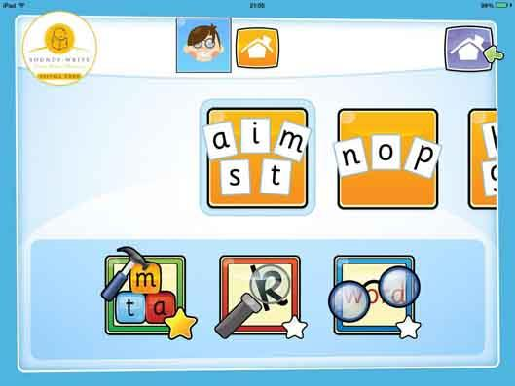
Useful Links
https://www.udemy.com/course/help-your-child-to-read-and-write/ Udemy SoundsWrite Course (free!)
SoundsWrite App

