Slide 1
WELCOME TO family learning
Year 2

Slide 2
What today is about:
Introduce SATS
When will they take place?
What will SATS look like for my child?
What papers will my child sit?
What if my child is finding some areas of the curriculum challenging?
How should we prepare the children for SATS?
How can we solve SATS questions?
Activities & practice with our children.

Slide 3
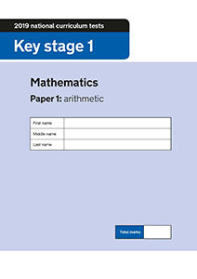
Introduction to SATS:
What are SATS?
SATs are standardised assessment tests administered by primary schools in England to children in Year 2 and Year 6 to check their educational progress.
There are six papers in total which will assess your child’s ability in Reading, Maths and English. This will also assess the quality of teaching and learning at our school.

Slide 4
Wellbeing at Floreat:
How do we ensure the well-being of children at Floreat is being kept ?
The children have sat the SATS papers before and really enjoy them!
We don’t use the word ‘test’ or ‘exam’, instead we use: challenge and phrases such like ‘it’s your time to show us what you can do.’
If a child becomes upset, we will give them a short break or take them out of the test.
We expose the children to lots of practice questions during morning lessons to mentally prepare them for the types of questions they will see.

Slide 5
When will they take place & what will it look like for my child?
The SATS will take place over the period of a week and will be held in May.
Your child will sit 6 papers in total.
They will complete each test, usually lasting from 15 minutes to 1 hour, depending on the test.
They have sat ‘mock tests’ many times and are very familiar with what this looks like and the set-up of each test.

Slide 6
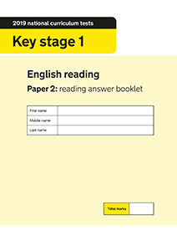
What papers will my child sit?
Your children will sit the following papers:
English Paper 1: Spelling
English Paper 2: Spelling, punctuation and grammar
Reading Paper 1
Reading Paper 2
Maths Paper 1: Arithmetic
Maths Paper 2: Reasoning

Slide 7
What if my child is finding some areas of the curriculum challenging?
Currently, we have SATS booster groups in place for each test type. These take place each afternoon with a teacher or teaching assistant.
We have focus groups during lessons which enables us to work on a specific skill with a small group of children at a time.
Extra morning reading support.
Further support at home with extra work from the day or communication with the class teacher on a particular subject their child is struggling with.

Slide 8
How should we prepare the children for SATS?
Each week we will be sending home personalised packs to help your child achieve in areas that they are currently struggling with.
When the children complete this pack, do let them complete it independently first. Then, go through the questions with them at the end.
Within this pack, there will be the following question types: SPAG questions, reading questions, maths questions and spellings. We are going to start these packs as of tomorrow (Friday 4th March).
The spellings will be set which contain words that Year 2 will be expected to know at the end of the year. This includes words with suffixes, prefixes, common exception words and homophones.
Home support is crucial for a child’s success.
Communication is key. Communicate with the class teacher if your child is finding a particular task challenging because your class teacher will input this into booster groups and lesson starters.

Slide 9
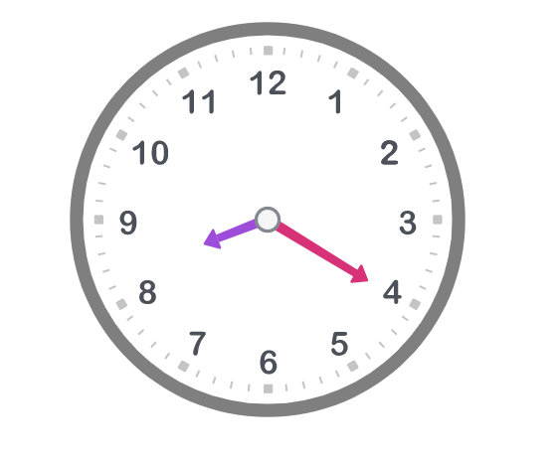
‘Quick fix’ maths activities to get started at home:
There are other ‘quick fix’ maths activities you could do, such as:
Teaching your child to tell the time.
Playing shop with your child and exposing them to coins and notes.
Things to note:
We tell the time as 5 minute intervals, for example, 5 past 9 or 20 past 8.
We avoid telling the time like this: 8:20 or 4:45 as children are not expected to know this at KS1.
We select a variety of coins and notes, but we don’t use the decimal point in KS1. For example £1.25 = £1 and 25p.

Slide 10
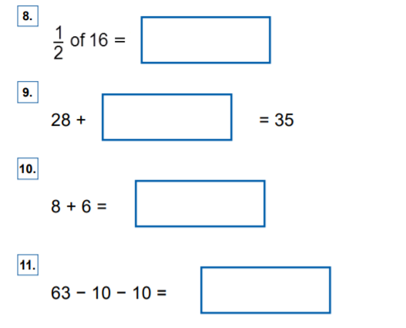
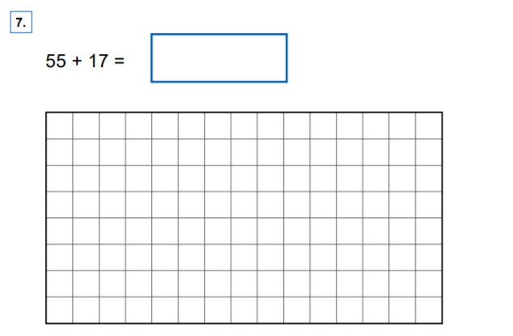
What do SATS questions look like?
Example of arithmetic questions

Slide 11
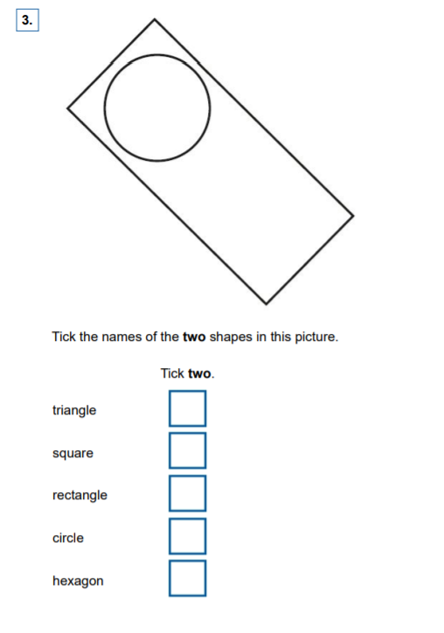
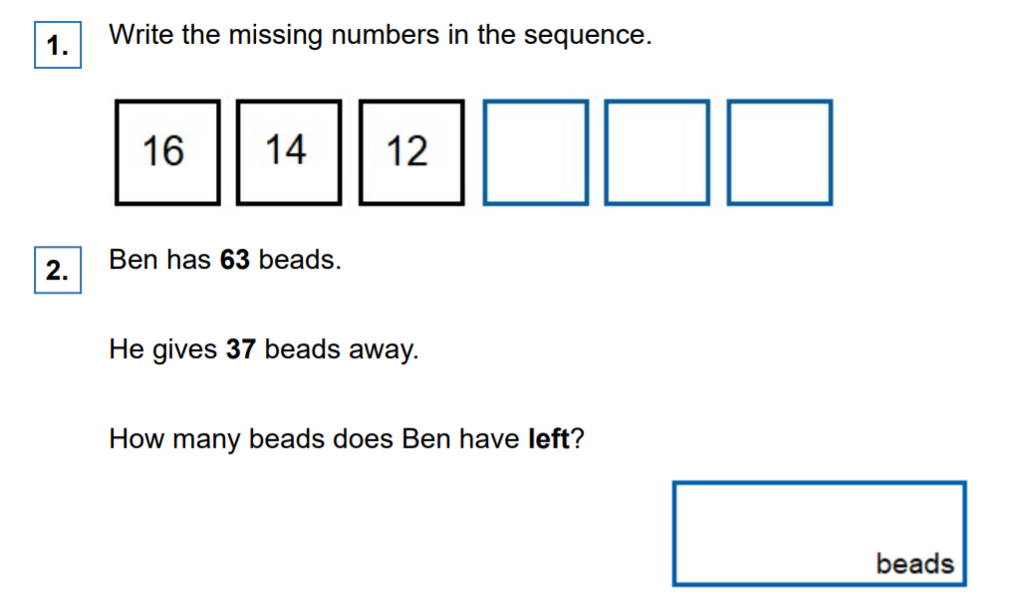
What do SATS questions look like?
Example of reasoning questions

Slide 12
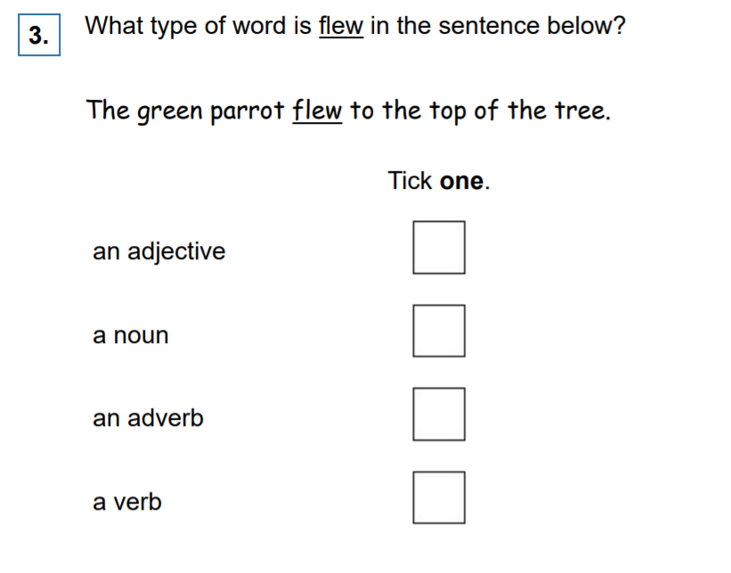
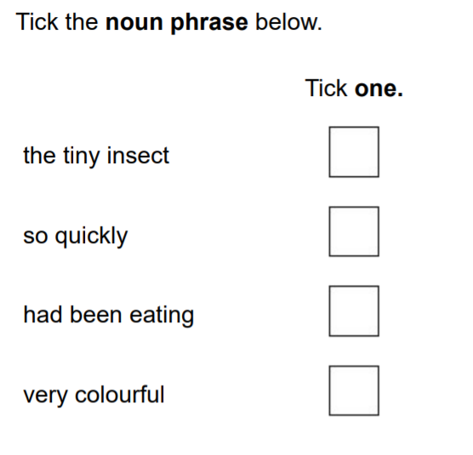
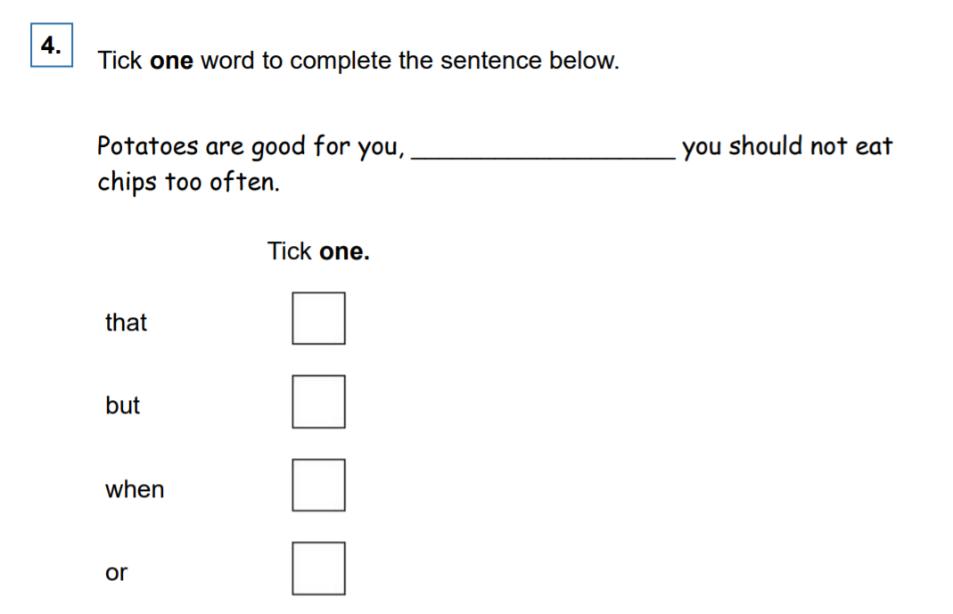
What do SATS questions look like?
Example of SPAG questions

Slide 13
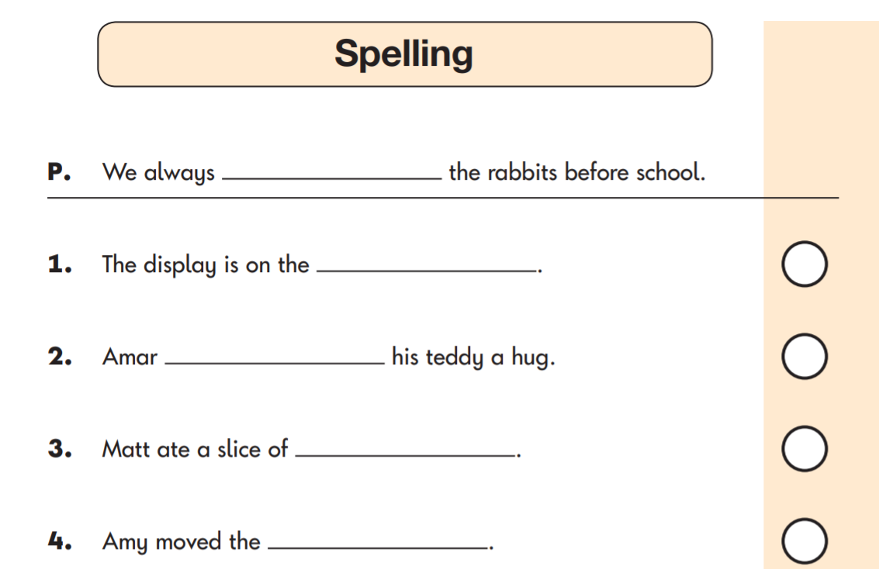
What do SATS questions look like?
Example of Spelling questions

Slide 14
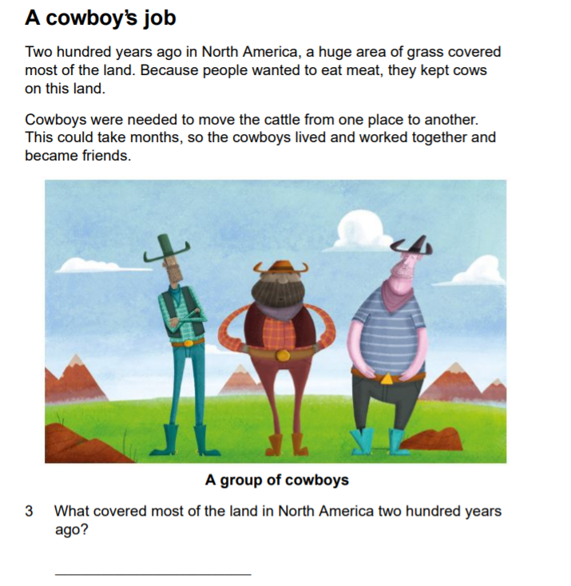
What do SATS questions look like?
Example of Reading 1 questions
In ‘reading: paper 1’, the children will have a piece of text that they will need to read and then they must answer the questions underneath.
A top tip would be to circle the key words from the question, then search the text.
Always read the questions first.

Slide 15
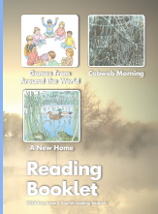
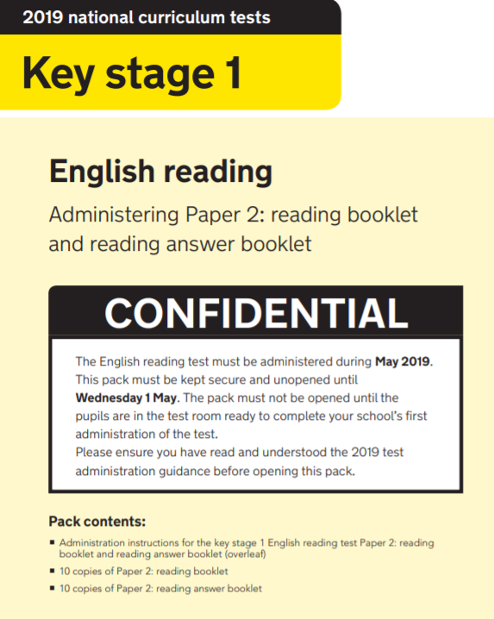
What do SATS questions look like?
Example of Reading 2 questions
During this test, the children will have a reading booklet and a separate booklet with questions inside. Some children find this challenging to move between the two papers. Our top tip would be: when you are reading with your child, write down some questions for them to answer at the end. They can have their reading book and questions and flick between the two, which will enable them to practise this skill.

Slide 16
Activities & Practice – 4 houses/4 tables
On your tables there are different tables for each paper. There is a SPAG table (Spelling and punctuation and grammar), a reading comprehension table, an arithmetic table and reasoning table.
Do let your children have a go at these questions independently first. After they have completed their first question, you can run through the answer and discuss how they know, or show them how to solve a particular question.
We will be circulating around the room to take any questions you may have.

