Slide 1

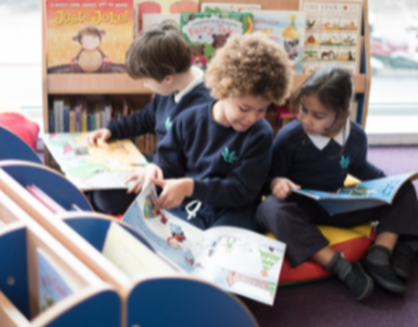
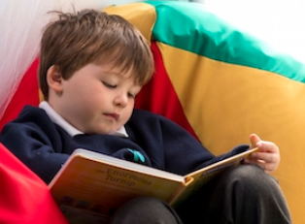

Year 1 Family Learning
Reading Focus

Slide 2

The importance of reading

Slide 3
Reading for pleasure ideas
Let the children pick their book, even if it might be slightly tricky. Even if they are looking at the images and making up a story, they are positively interacting with a book.
Get the children to make a ‘secret’ reading den that only they can go in
Read your own book when they read from time to time
Pillows and relaxing music
Create a fun reading record where the children get pictures of themselves reading in different locations
Share books with friends – recommended books given by a friend always sparks interest
Find a book that really sparks their interest
Library visits!

Slide 4
What is our reading offer in Year 1?
1:1 daily readers
Whole class guided reading sessions
Daily story time
Library sessions
Buddy reading with other year groups
Daily sounds lessons
Reading for pleasure moments
Opportunities to read/be read a wide variety of texts.

Slide 5
Reading skills
As we progress through Year 1 the children become more fluent in reading and we begin to move onto looking at the children's comprehension in reading. We also look at the child as a reader, what do they like to read for fun.
What reading skills are they starting to learn and develop?
Applying phonic knowledge to decode words
A knowledge of fiction and non-fiction
Linking what they have read/hear to their own experiences
Predictions
Inference
Sequencing

Slide 6
Guided Reading
Excitingly, we have started whole class guided reading!
The Lighthouse Keepers Lunch is our current text
These sessions run for approximately 30 minutes a day
Within them we read perhaps one or two pages
We ask a wide variety of questions that look at different reading skills such as; inference, decoding, predictions, sequencing, vocabulary knowledge
Within these sessions we have rich partner and whole class discussions.
Let’s show you how we do this!

Slide 7
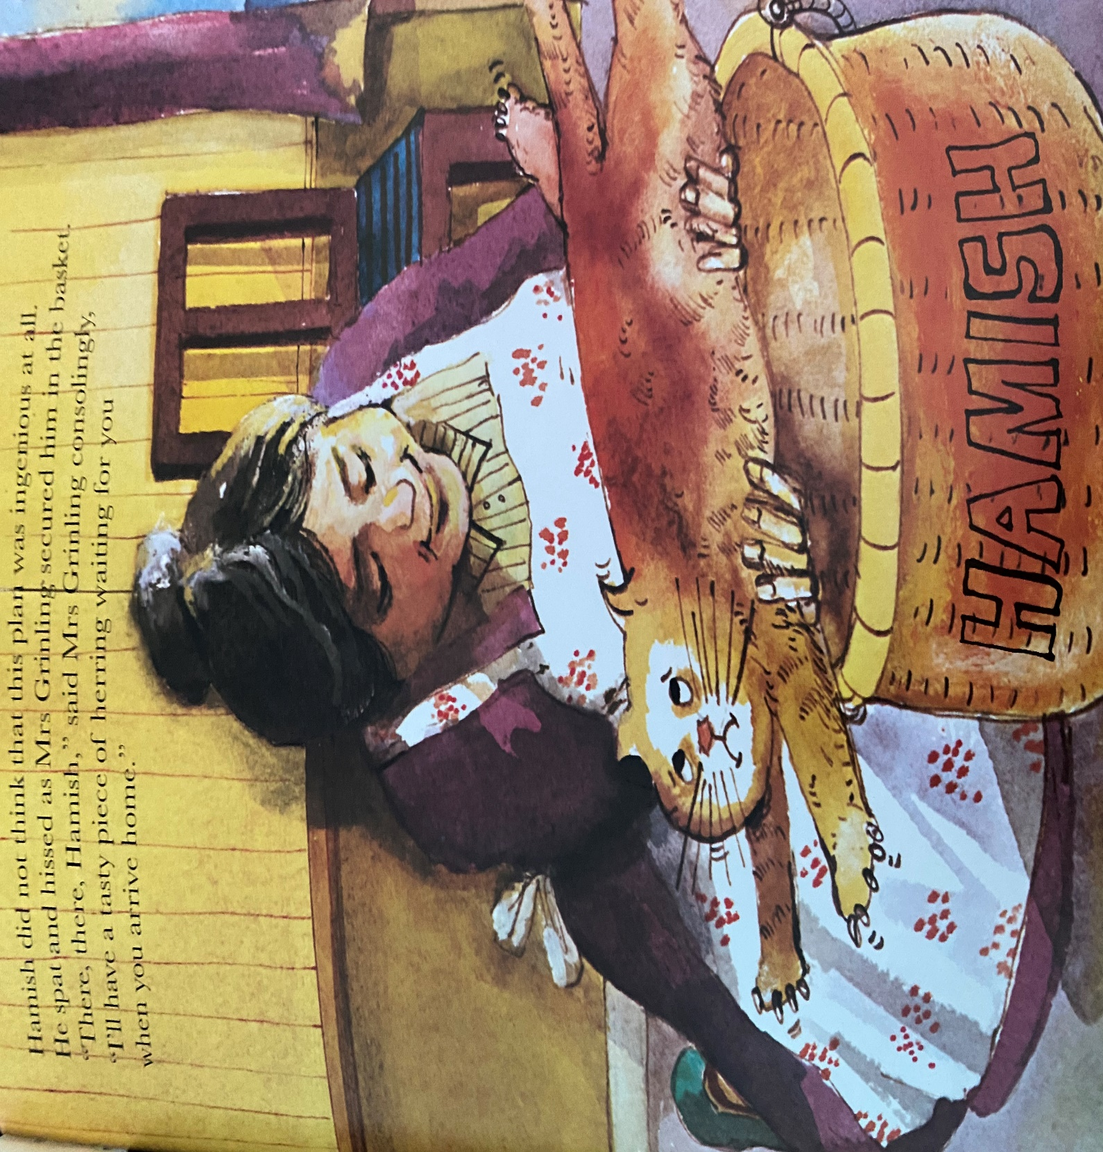
Notes:
What happened previously?
Miss Clark reads while chn follow with fingers. Stop at consolingly – what might this mean (read sentence again)? Continue reading.
Volunteer to read sentence 1 – thumbs up.
Volunteer to read sentence 2 – thumbs up –
How does Hamish feel?
How do you know?
Why does she need to secure Hamish in the basket?
Volunteer 3 to read sentence 3 – thumbs up.
quick fire round of fastest finger – point to a word that means yummy (tasty).

