Slide 1
What is phonics and why is it important?
Phonics is the approach associated with the teaching of reading in which phonemes (sounds) associated with particular graphemes (letters) are pronounced in isolation and blended together

Slide 2
What does a child need to know:
Letters are symbols that represent sounds.
A sound can be spelled by 1,2,3 or 4 letters.
dog street night dough
2 letters 1 sound are called a digraph
3 letters 1 sound are called a trigraph
-The same sound can be spelled in different ways.
rain break gate
a_e is called a split digraph

Slide 3
Pure sounds
It is so important that the children know the pure sounds.
a b c d e f g h i j k l m n o p q r s t u v w x y z
ng ch th qu sh ck ff ll

Slide 4
Skills
Blending pushes the sounds together to build a word.
Segmenting is the ability to pull sounds apart.
Phoneme manipulation is the ability to isolate sounds within a word and explore how they are represented.
Notes:
- These are the skills that are needed to learn to read and write however this terminology is adult language and not child talk.

Slide 5
Everyday words
Every word is decodable. In our programme we have no ‘tricky’ words or ‘magic’ letters.
In the word _______ this sound is _____.
eg the, knock, wash
Notes:
- It is based on a child’s phonic knowledge as to whether they have met that representation yet.

Slide 6
Three Pillars of Reading
Love of Reading
Decoding
Language Acquisition
Notes:
- develop a love of reading
safe, quiet, happy, encouraging, special, personal
- Decoding
Saying the sounds and reading the word
- Language acquisition
Talking about the text, discuss the words, inference, retrieval, preditions
Calm space
- No distractions
- It should be a special time
-Its not about finishing the book

Slide 7
Reading at home with your child
Gestures are vital for success when reading.
Key phrases including ‘say the sounds and read the word’ keep children focused.
Pronunciation of the sounds must be pure to enable blending.
Listen for the error that your child is making allows you as the adult to be specific in your support.
Notes:
Bek to be child and model errors Bex to fix errors

Slide 8
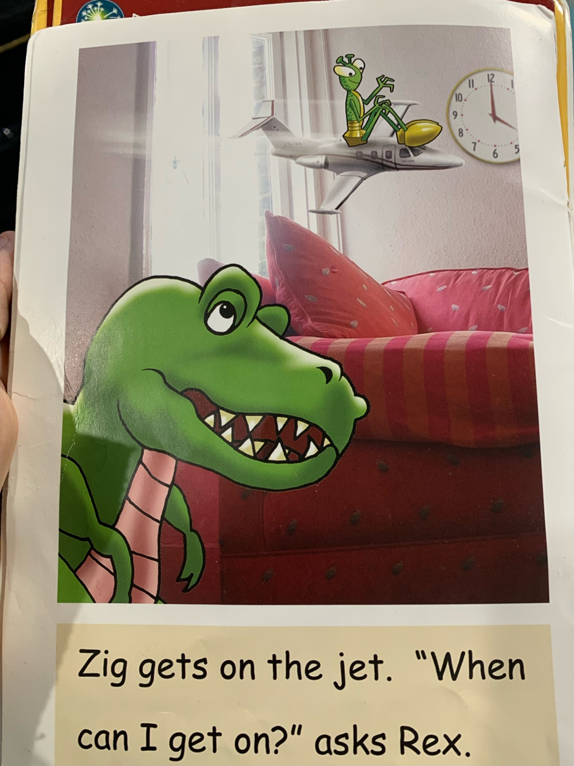
Reading at home with your child
Notes:
Bek to be child and model errors Bex to fix errors

Slide 9
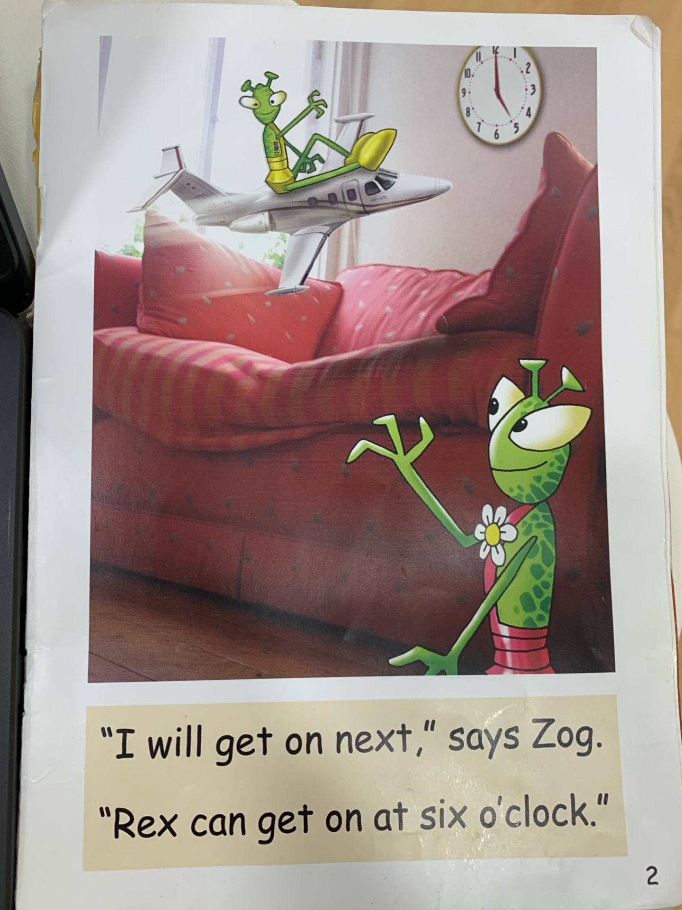
Reading at home with your child
Notes:
Bek to be child and model errors Bex to fix errors

Slide 10
Key Phrases to Support Reading
Say the sound and read the word In this word this letter/digraph/trigraph represents the …. sound. That can represent the sound ….. but in this word is represents the sound …..

Slide 11
Notes:
Early Writing
- a child is processing a lot when writing
- sitting, tummy muscles
- Pencil grip, formation ,size control
- sounds
- hearing the sound, saying the sound, the resresentation of the sound,
- finger spaces,
- which line to write on
- what was the next word
- arm position to form correct shapes

Slide 12
Writing at Home With Your Child
Correct pencil grip where possible.
Model sound formation if you notice mistakes.
Avoid letter names.
A child needs to be able to say the sentence before they write it- counting the number of words, check punctuation, reread sentence when finished.
Check which part of the word/sentence the child is struggling with.
Notes:
Bek to be child and model errors Bex to fix errors

Slide 13
Key Phrases to Support Writing
​
Say the sounds and write the word​
Which part of the spelling are you finding difficult?​
We spell _________ like this.​ (write the sound for the child to see)

Slide 14
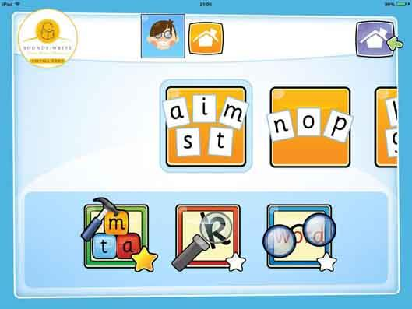
Useful Links
https://www.udemy.com/course/help-your-child-to-read-and-write/ Udemy SoundsWrite Course (free!)
SoundsWrite App

