Slide 1

Family Learning
Sounds

Slide 2
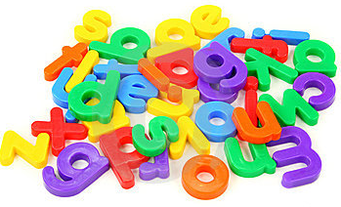
What your child needs to know:
Letters are symbols that represent sounds.
A sound can be spelled by 1,2,3 or 4 letters.
dog street night dough
-The same sound can be spelled in different ways.
rain break gate

Slide 3
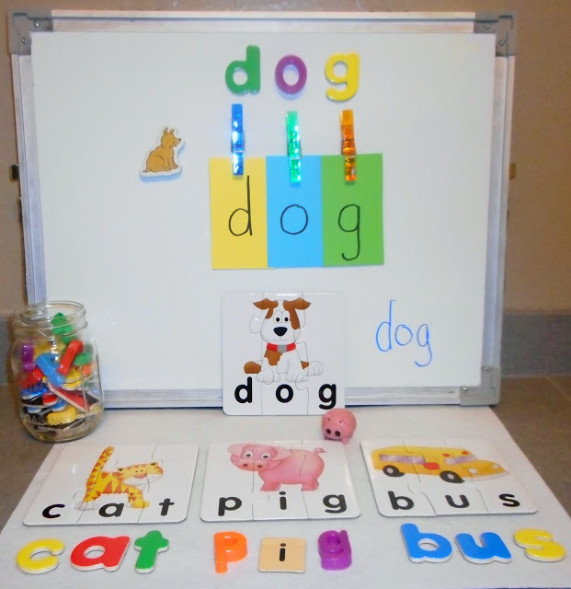
What sound skills are important ?
Blending is a skill that pushes the sounds together to build a word.
Segmenting is the ability to pull sounds apart.
Phoneme manipulation is the ability to insert sounds into and delete the sounds out of words.

Slide 4

Saying the Sounds
a b c d e f g h i j k l m n o
p q r s t u v w x y z

Slide 5
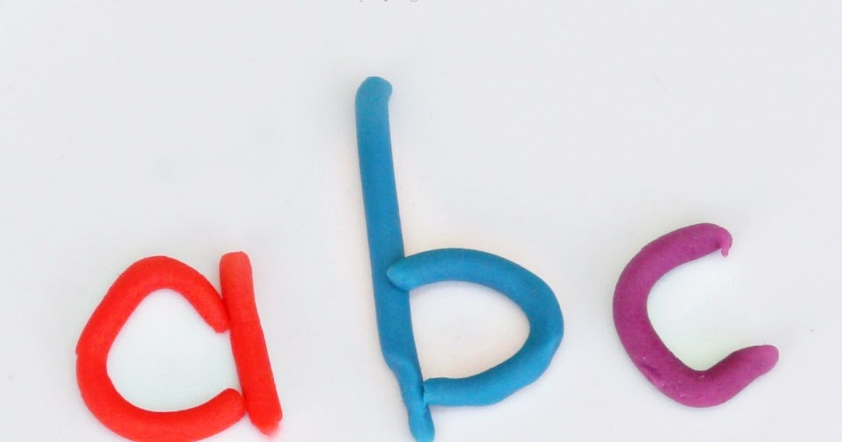
How we support your child’s sound knowledge…
At school we explore sounds through:
Daily ‘Sounds Write’ session
Play (at choosing tables, in role play areas or Word Builder wall)
Sound intervention groups (targeting specific sounds)
Daily routines (calendar, transitions, incidentally)

Slide 6
What does Sounds Write look like ?
Word builder
Sound swap
Symbol search
https://www.udemy.com/help-your-child-to-read-and-write/

