Slide 1
Year 5 Family Learning

Slide 2
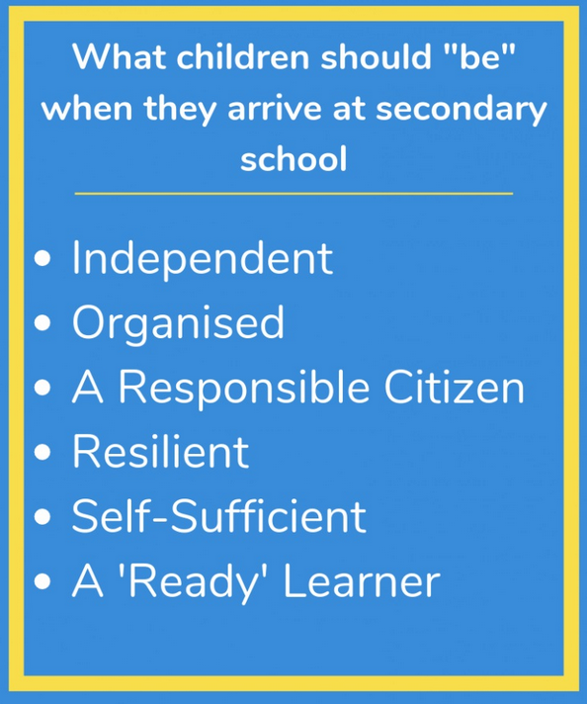
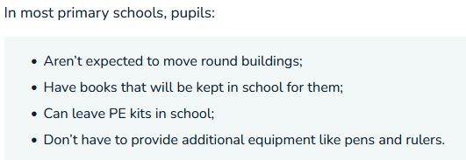
“Year 7 ready”

Slide 3
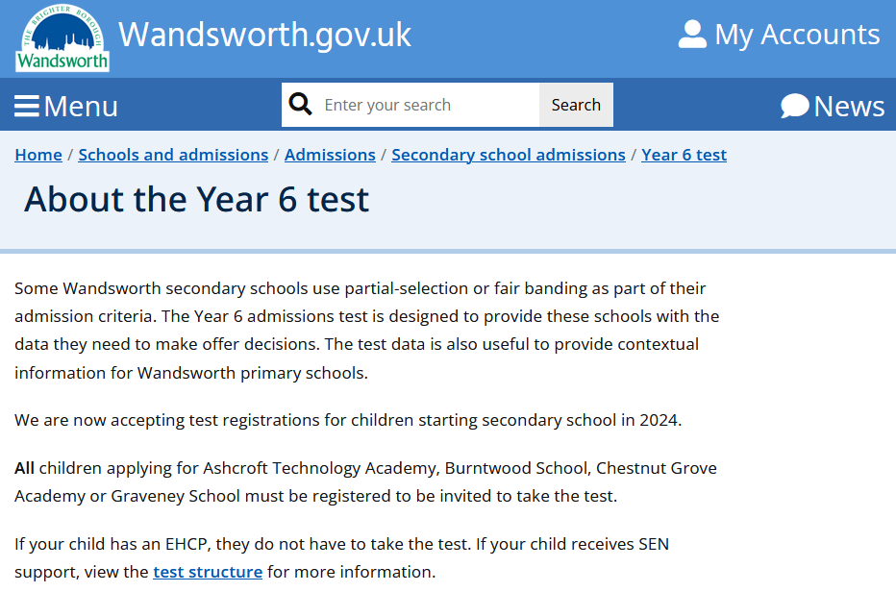
https://www.wandsworth.gov.uk/about-the-year-6-test/

Slide 4
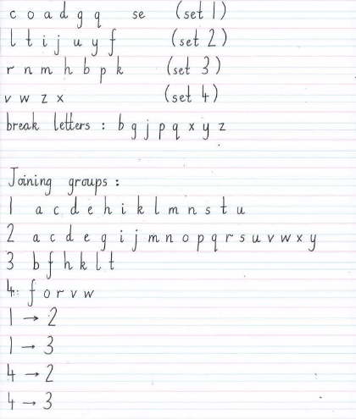
Handwriting
https://www.floreatwandsworth.org.uk/ckfinder/userfiles/files/FW%20Handwriting%20Expectations.pdf

Slide 5
Oracy
Academic Achievement: Proficient oracy skills are closely linked to academic success. The ability to articulate thoughts clearly aids comprehension and expression in all subjects.
Confidence: Oracy builds confidence. The more comfortable your child is expressing themselves verbally, the more likely they are to actively participate in class discussions, ask questions, and engage with learning.
Social Skills: Effective communication is fundamental to building positive relationships. Oracy helps children develop strong interpersonal skills, making them effective collaborators and communicators.

Slide 6
Taboo Word: Elephant
Cannot say: Big, trunk, tusks, gray, wildlife

Slide 7
Taboo Word: Maths
Cannot say: Numbers, calculations, addition, subtraction, lessons

Slide 8
Taboo Word: Banana
Cannot say: Yellow, peel, tropical, monkeys love it, snack

Slide 9
Would you rather have a pet dragon or a pet unicorn? Why? Give me at least 3 reasons. Firstly, … Secondly, … Finally,…

Slide 10
Would you rather have the power to time travel to the past or the future? What era or time period would you choose? Give me at least 3 reasons. Firstly, … Secondly, … Finally,…

Slide 11
Would you rather have the job of being a detective solving mysteries or an astronaut exploring space? Why? Give me at least 3 reasons. Firstly, … Secondly, … Finally,…

Slide 12
Can you have happiness without sadness? Why or why not? Give me at least 3 reasons. Firstly, … Secondly, … Finally,…

