Slide 1
Welcome to Year 2 Family Learning!

Slide 2
Why is reading so important?
The Journal of Developmental and Behavioral Pediatrics
Children who hear 1 short story per day by the age of 5 years will have heard around 290,000 words more than children who have not had stories read to them.
Notes:
AM

Slide 3
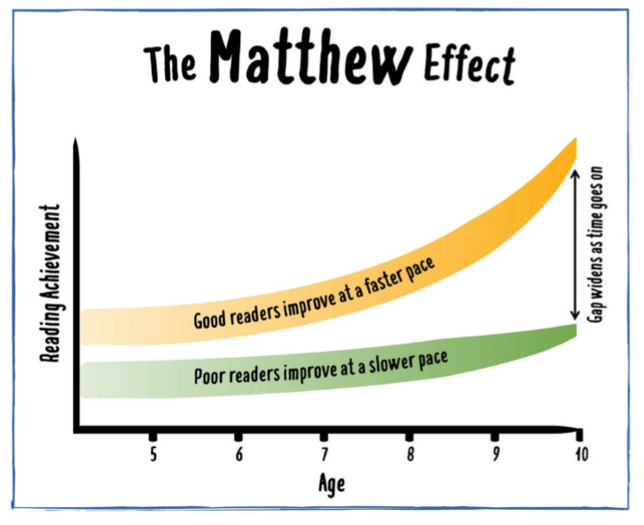
The old saying does often seem to hold true: the rich get richer while the poor get poorer, creating a widening gap between those who have more and those who have less.
The sociologist Robert K. Merton called this phenomenon the Matthew effect.
Notes:
AM

Slide 4
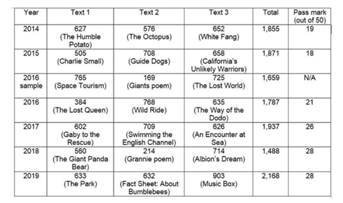
Check Point
Notes:
AM

Slide 5
Three Pillars of Reading
Decoding
Love of Reading
Language Acquisition and comprehension
Notes:
AM

Slide 6
Decoding
Children take part in daily phonics.
1:1 reading with the class teacher to work on specific skills and personalised coaching.
Small group sessions to target specific sounds and skills.
Segmenting | Skill for spelling
Blending | Skill for reading
Phoneme Manipulation | Skill for sound isolation both reading and spelling
Notes:
AM

Slide 7
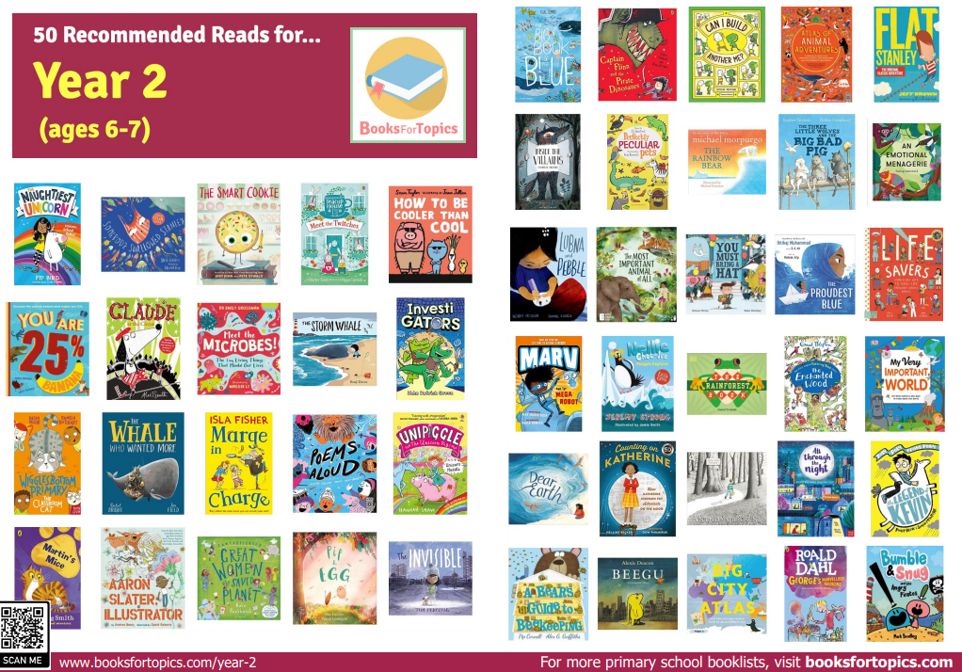
How do we foster a love of reading?
Weekly Library visits (Tuesday)
Class books shared daily for pleasure.
Notes:
EM

Slide 8
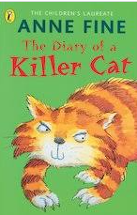
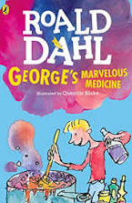
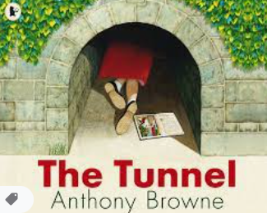
Notes:
AM

Slide 9
Whole Class Reading
Just read!
Children apply skill
Vocab
Close read and teach specific skill
Broaden out
3 in 3
Notes:
AM

Slide 10
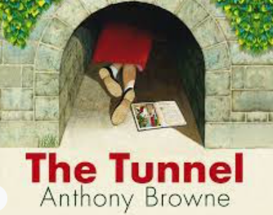

Slide 11
Session 1 - Vocabulary
alike
roughing and tumbling
soundly
crept
frighten
fought
impatient
waste ground
mustn’t
goblins
Notes:
Alike- when something is like or similar to something else
R and T- games that are more physical and have less rules
Soundly- deeply no waking
Crept- move slow and quietly
Waste ground- empty land where nothing grows, people often dump rubbish there
Goblins- mischievous mythical creature

Slide 12
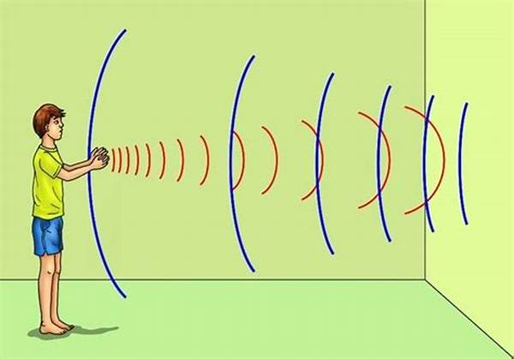
Session 2 – Echo Reading
Echo reading is a strategy used to support readers to improve intonation, tone, pace, confidence.
The teacher or lead reader reads out a short piece of text and the pupil echoes (repeats) it back.
Notes:
AM

Slide 13
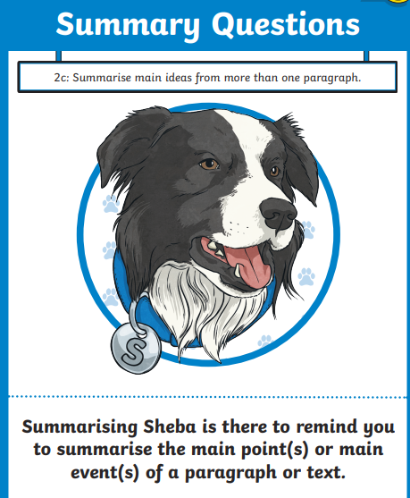
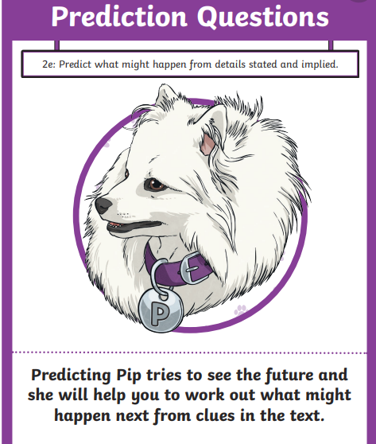
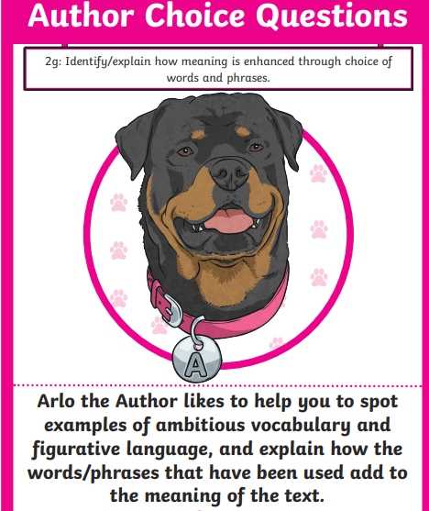
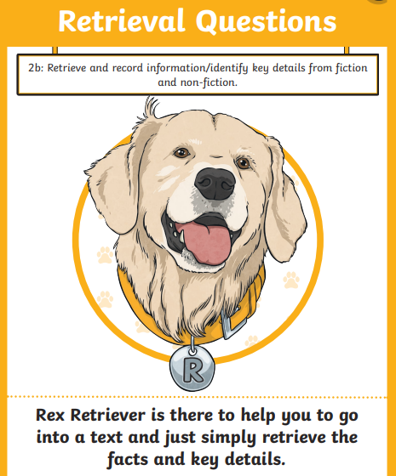
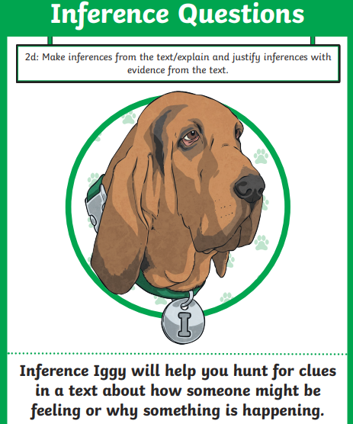
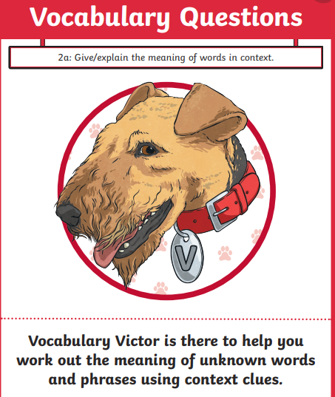
Session 3 – Teach Reading Skills
Notes:
AM

Slide 14
Examples of simple retrieval questions:
1. Where does Paul sit when he takes off his muddy boots?
2. What does Paul do after he puts his sweaty clothes by the washing machine?
Notes:
AM

Slide 15
Notes:
EM

Slide 16
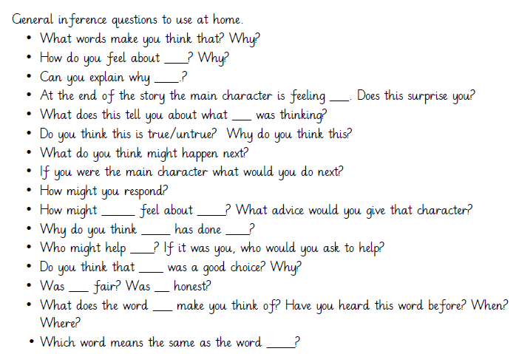
Notes:
EM

Slide 17
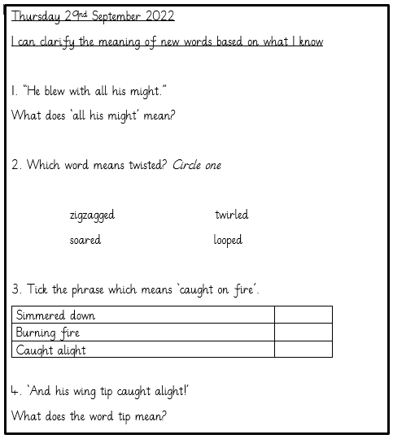
Session 4 – Independent Learning
Notes:
AM

Slide 18
Session 5 – Range of short texts
Notes:
EM

Slide 19
What can I do at home?
Reading for pleasure: non-fiction, first news/happy news, library, book talk
Daily reading (10-15 minutes) –Books should be in school bags everyday.
Reading records (every Friday checked by us)
Reading home learning (reading skills)
Book Fair (It is next week!)
Notes:
EM

Slide 20
Session 1 - Vocabulary
alike
roughing and tumbling
soundly
crept
frighten
fought
impatient
waste ground
mustn’t
goblins
Notes:
Alike- when something is like or similar to something else
R and T- games that are more physical and have less rules
Soundly- deeply no waking
Crept- move slow and quietly
Waste ground- empty land where nothing grows, people often dump rubbish there
Goblins- mischievous mythical creature

Slide 21
Echo Reading
Once upon a time there lived a sister and a brother who were not at all alike. In every way they were different. The sister stayed inside on her own reading and dreaming. The brother played outside with his friends laughing and shouting, throwing and kicking, roughing and tumbling.
Notes:
EM

Slide 22
Session 3-4 – Independent Learning
Notes:
AM

