Slide 1
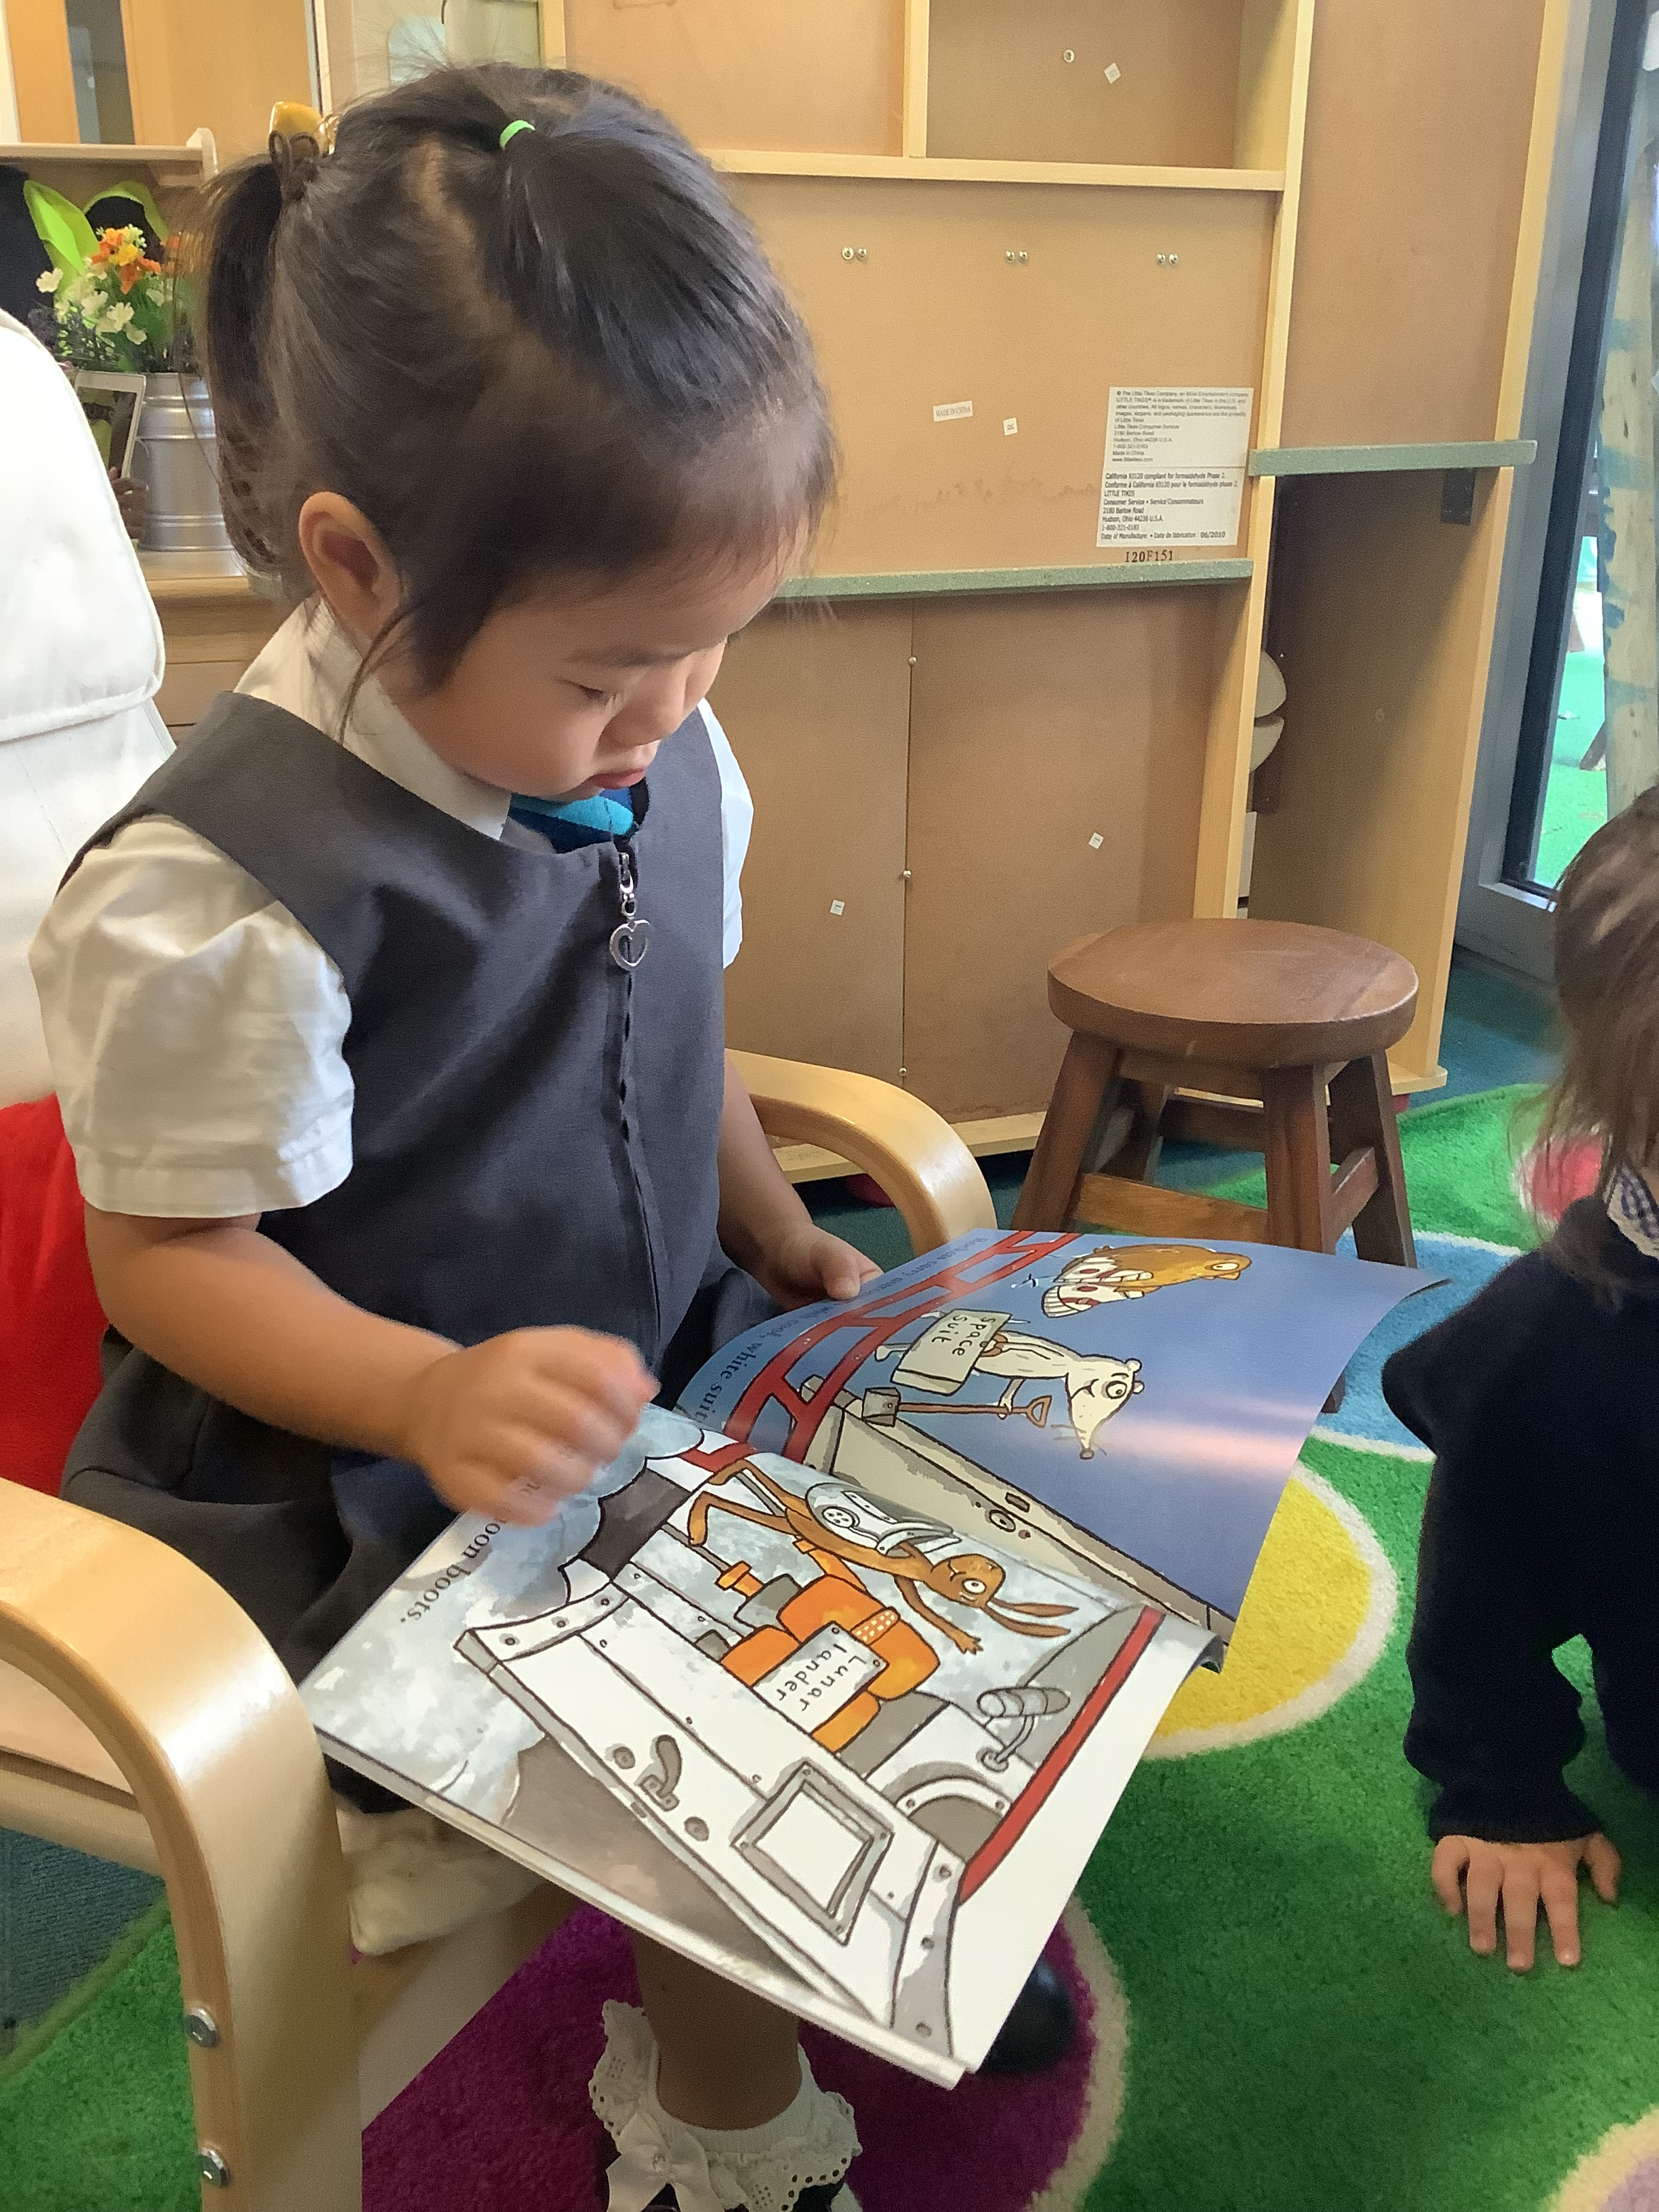
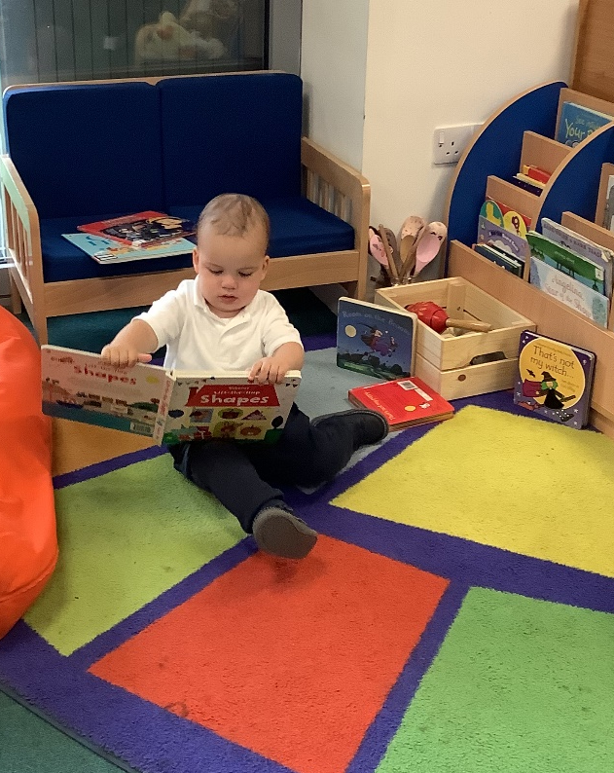
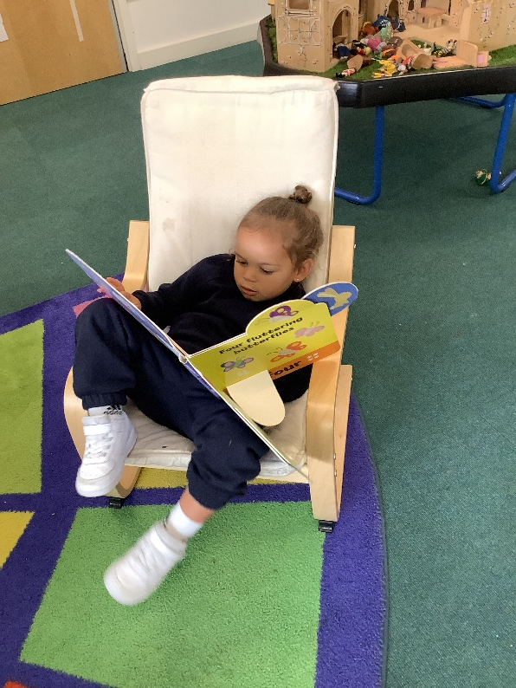
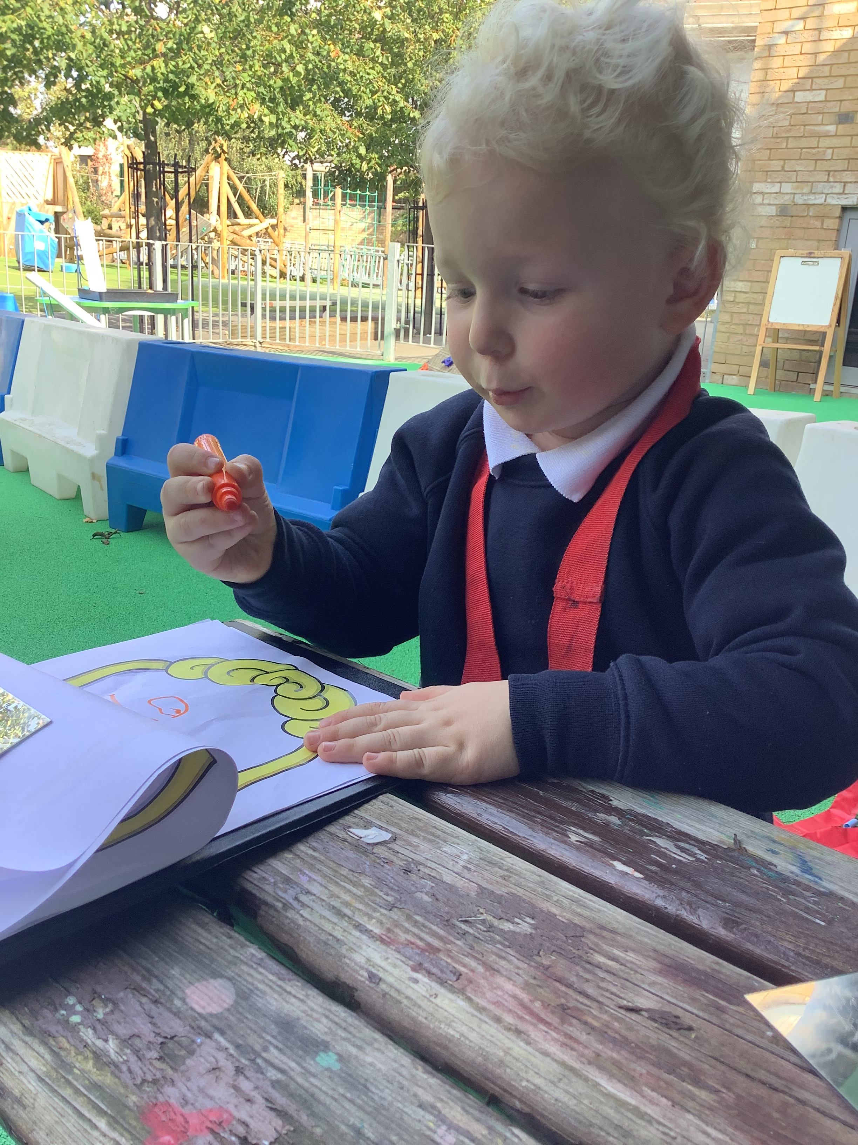
Early Language Skills

Slide 2
Language Gap
*The wording of this is being debated as it is felt that it does not recognise different dialects, sign language, different life experiences.
Oxford University Press produced a report on 2017 (pre pandemic) that showed:
Children in the EYFS who are exposed to lots of different words/language types will have heard on average 43,926 words per day compared to those who don’t which average 7,239 words per day.
That is a 35-million-word difference by the time children start in reception.
Statistics
Children with poor language are 3x as likely to have mental health issues
Children with poor vocabulary are 2x as likely to be unemployed

Slide 3
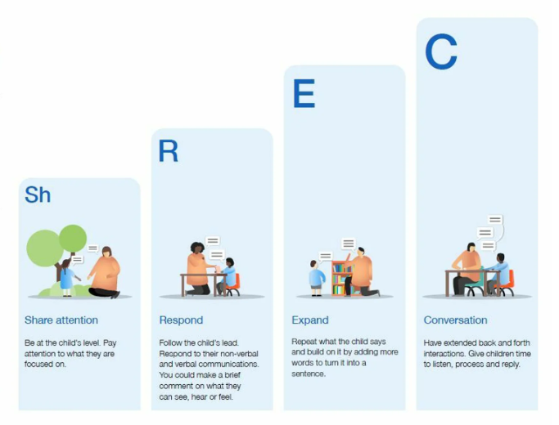
EEF- ShREC Approach
​“When done well, high quality interactions often look effortless, but they are not easy to do well”.
https://www.youtube.com/watch?v=HJSfZRtUMXk

Slide 4
Importance of exposing children to language variations
Spoken Language
Less formal
Spontaneous
Listening skills needed
Tone and expression can be used to help the listener
Written Language
Often repetitive
Often more formal sentences
Planned structure sentences
Pictures used to enhance meaning
Decoding/segmenting skills
Children will ‘tune out’ if they don’t understand at least 95% of the wording used. Children need to be exposed to word 17 times before it goes into long-term memory.

Slide 5
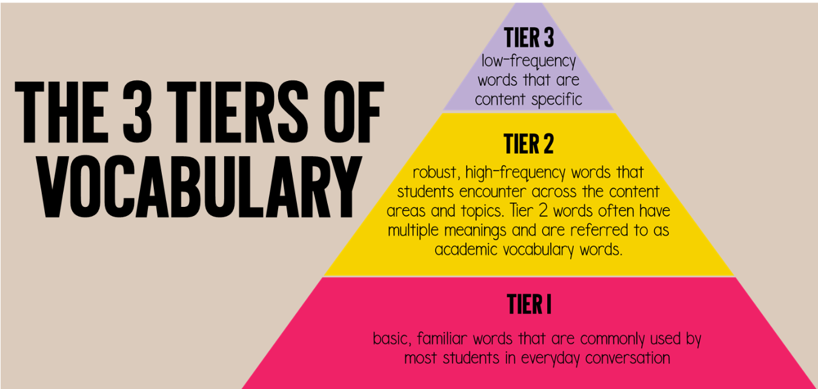
Tier Language System
In school we focus on tier two language.
Rich texts
Multiple meanings
High frequency

Slide 6
What do we do at Floreat?
Repetition
Confident voice
Extended sentence
Language audits
Exposure to poetry, rhymes, traditional tales, alliterations, rich texts

Slide 7


