Slide 1

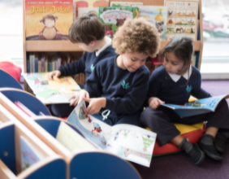

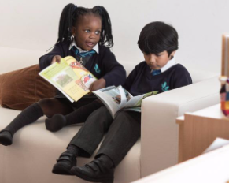

Reading
&
Looking ahead

Slide 2

What was your favourite book as a child?
Why?

Slide 3



What can I do at home?
Reading for pleasure: non-fiction, first news/happy news, library, book talk
Daily reading (10-15 minutes)
Reading records (every Friday checked by us)
Reading home learning (reading skills)
Ask questions
Notes:
EM

Slide 4

Activity 1 – Echo Reading
Fred and the Ferocious Dragon
There once was a poor child called Fred, who lived on the edge of a dark, damp forest. Early one crisp, frosty morning, he woke up and was about to leave for school when his mother warned him… “Beware of the ferocious dragon in the cavernous cave!”
Not wanting to be late, Fred ran and he ran and he ran until he approached the cavernous cave. Were the rumours about the dragon true or was it just fantasy? Fred took a deep breath and peered cautiously inside.
Notes:
Something you can do at home if you feel your child struggles with intonation / expression

Slide 5
How can we promote a love for reading?
Embed daily reading into our schedule
Ensure a structured lesson approach creating consistency in teaching
Introduce more up to date and engaging books for children
Visiting our library (school and elsewhere)
Reading records
Exciting book corners
Exciting book talk
Celebrating reading events throughout the year
Notes:
Reading and inference etc can still happen if the child reads independently – you can glance over the page and ask some questions, it can happen when they have listened to you read and it can be from just one page of text.
Prediction and inference skills can even be from films!

Slide 6
Reading Records
What are the expectations for children and parents?

Slide 7
KS2 Reading
Just read!
Children apply skill
Vocab & General knowledge
Close read and teach specific skill
PiXL
3 in 3

Slide 8

Vocab
Select – choose words to teach.
Explain – use games/drama/pictures/discussion
Explore – prefix/suffix/etymology
Consolidate – coming back to words learnt

Slide 9

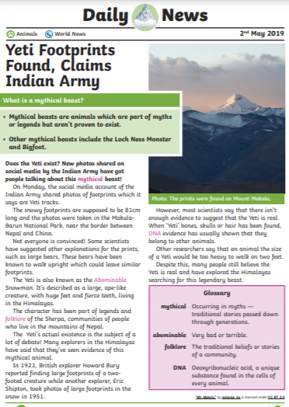
General Knowledge
What pieces of general knowledge do your children need to know to fully understand the text?
Notes:
Sats questions are sometimes quite rogue and a good understanding of general knowledge is often what it required.
An assumption is made of their knowledge of high level vocabulary and it is important that they can understand words in context. Keep your language high level and encourage pupils to think about what the word might mean and why before explaining the definition to them.

Slide 10
Just Read!
This is done without stopping.
Usually a whole chapter (or two).
Teacher
Pairs
Whole class
Groups
Individuals

Slide 11
Close Read
Choose extract from chapter(s) that is the most difficult to understand/has the most to be gained from discussion.
Teacher to teach reading skill.

Slide 12
Close Read
Retrieval
Inference
Fact/opinion
Author’s choice
Develop own views
Prediction
Sequencing
Summarising
Mood

Slide 13
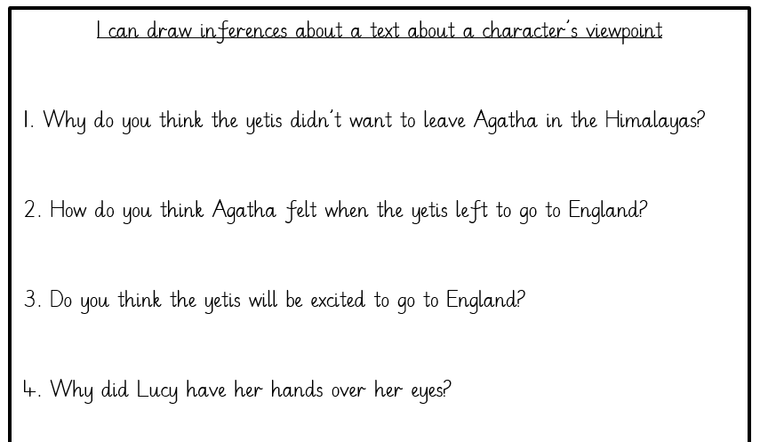
Apply Skills
Children to apply skills they have learnt in the previous lesson.

Slide 14
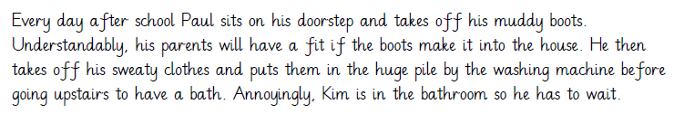
Examples of simple recall questions:
1. Where does Paul sit when he takes off his muddy boots?
2. What does Paul do after he puts his sweaty clothes by the washing machine?
Notes:
AM

Slide 15
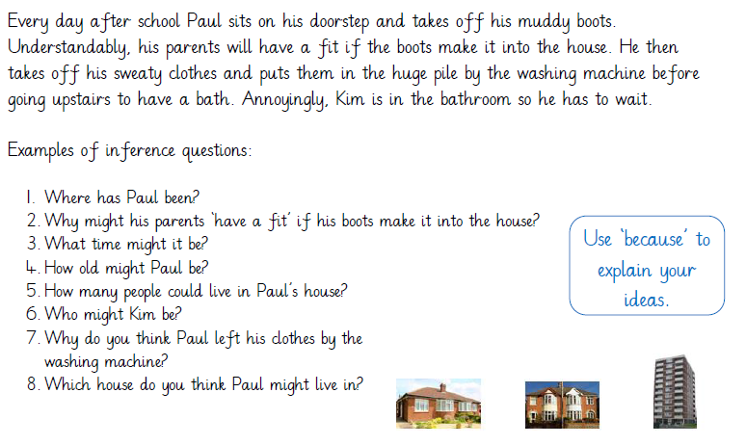
Notes:
EM

Slide 16
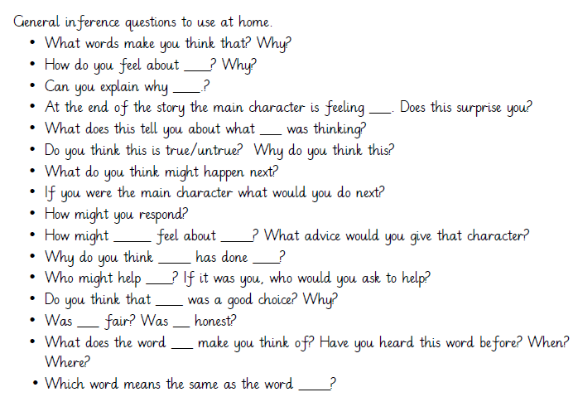
Notes:
EM

Slide 17
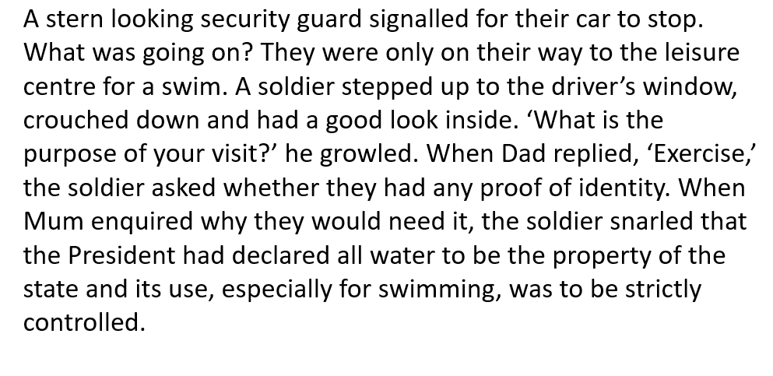
PiXL 3 in 3

Slide 18
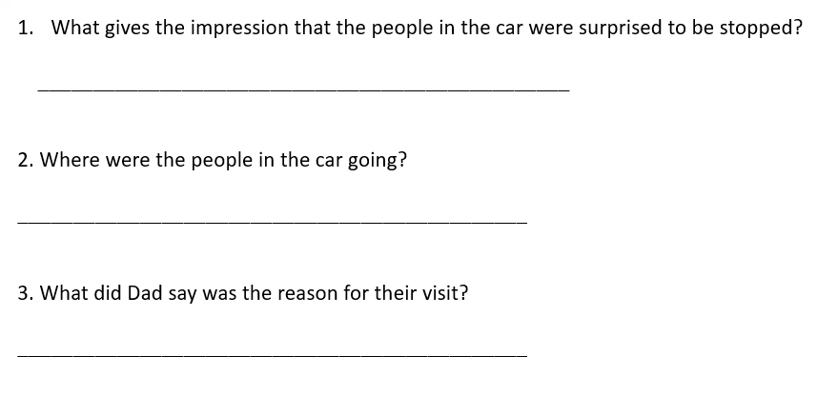
PiXL 3 in 3

Slide 19

Looking ahead to Year 6!
https://www.floreatwandsworth.org.uk/admissions/planning-ahead---secondary-schools

Slide 20

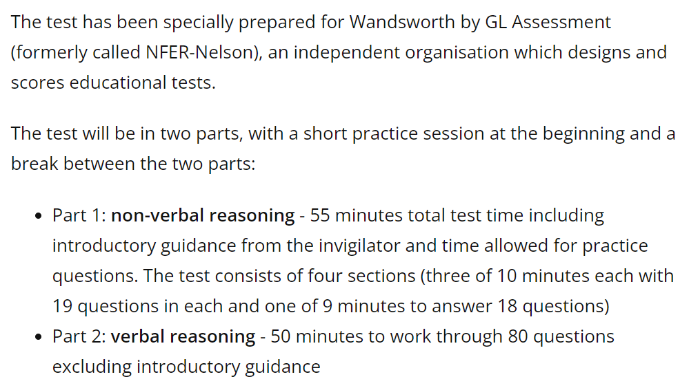
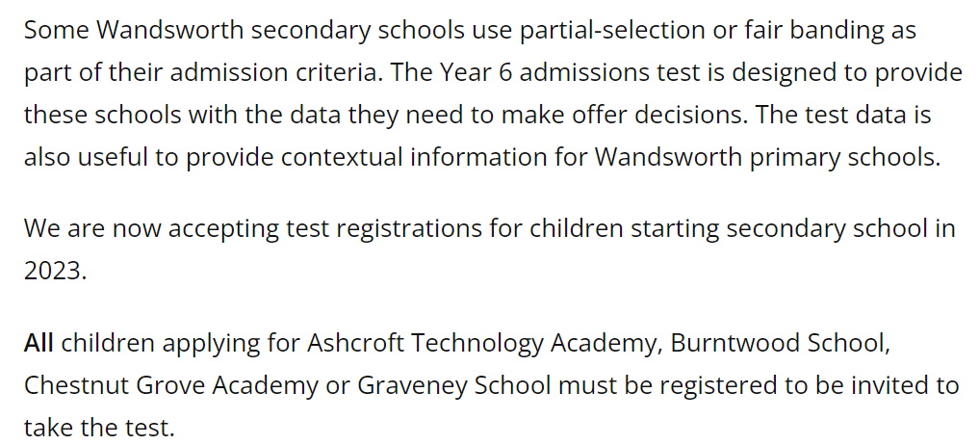
Wandsworth Test
https://www.wandsworth.gov.uk/schools-and-admissions/admissions/secondary-school-admissions/year-6-test/about-the-year-6-test/

Slide 21
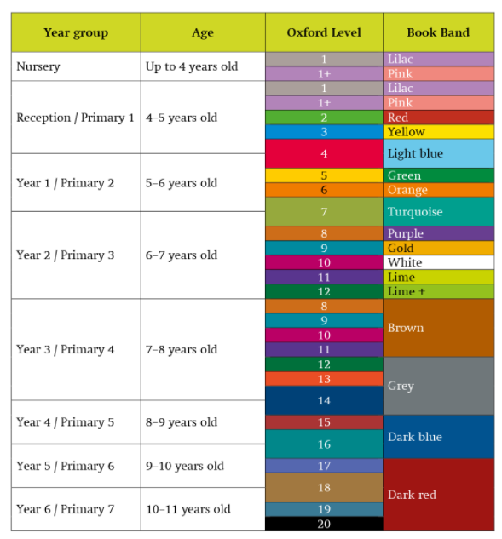
Oxford Levels &
Book Bands

