Slide 1
Family Learning
Mathematics

Slide 2
Birth to five matters….
Mathematics for young children involves developing their own understanding of number, quantity, shape and space. Young children have a natural interest in quantities and spatial relations – they are problem-solvers, pattern-spotters and sense-makers from birth. This curiosity and enjoyment should be nurtured through their interactions with people and the world around them, drawing on their personal and cultural knowledge.
Every young child is entitled to a strong mathematical foundation which is built through playful exploration, apprenticeship and meaning-making
Effective early mathematics experiences involve seeking patterns, creating and solving mathematical problems and engaging with stories, songs, games, practical activities and imaginative play. Plenty of time is required for children to revisit, develop and make sense for themselves.
It is crucial to maintain children’s enthusiasm so they develop positive self-esteem as learners of mathematics and feel confident to express their ideas.

Slide 3
Introducing maths to children
Be positive in your language
Sing number songs
Make observations from the world around you
Have resources in your house that allow the children to explore the concept of maths
Make it part of your daily routine

Slide 4
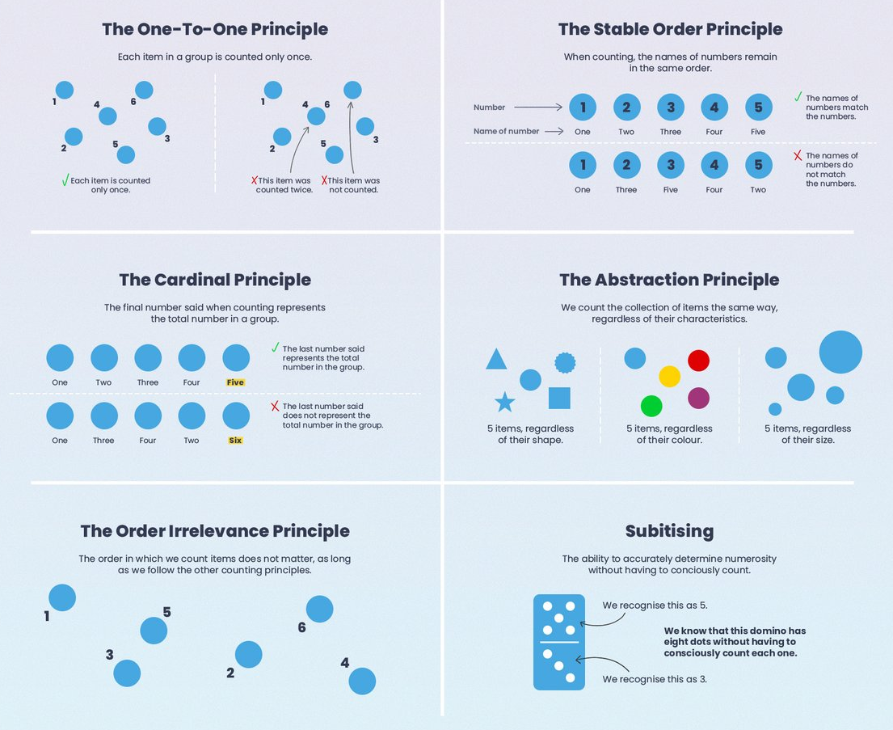
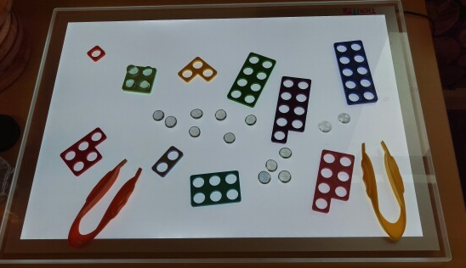
5 Principles of Counting
Know the correct order
One-to-one correspondence
Understanding the cardinal number
Order irrelevance
To understand that abstract items can be counted too

