Slide 1
Welcome to Family Learning.

Slide 2
Our focus will be….
Key Number Skills

Slide 3
Year 2 Maths
Consolidation of number knowledge.
Application of number knowledge to abstract methods.
Use number knowledge in a range of question types.
Culminating in Standardised Government Testing (SATs!)

Slide 4
A solid understanding in number skills, lays the foundation for all a successful mathematician.

Slide 5
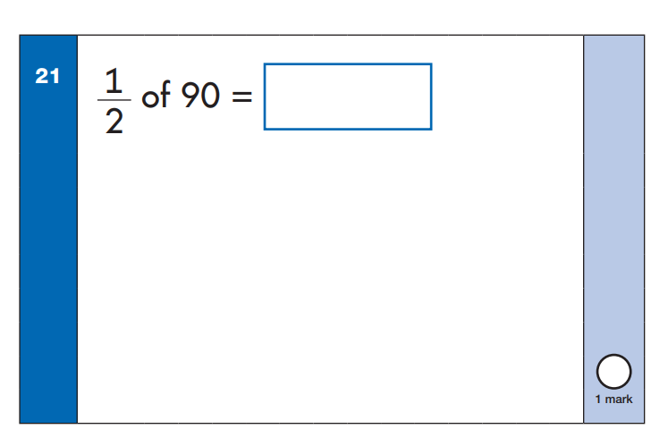

Slide 6
Making Connections
What do I already know?

Slide 7
Quick Maths!
Halving to 20
Doubling any one digit number
Number bonds to 20
Recognise odd and even numbers
Place value (value of number)
Recognise silly mistakes

Slide 8
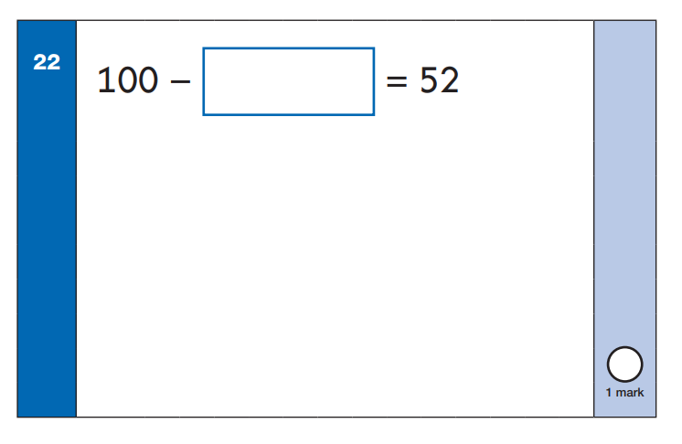

Slide 9
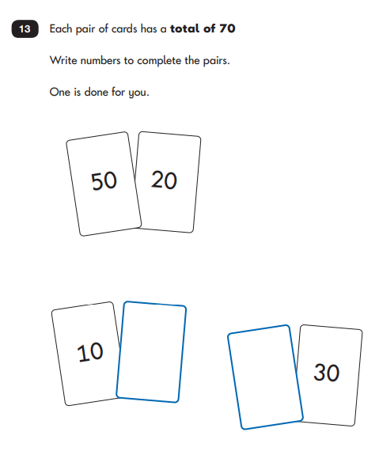

Slide 10
Activity Time!

