Slide 1
Phonics
What does a child need to know:
Letters are symbols that represent sounds.
A sound can be spelled by 1,2,3 or 4 letters.
dog street night dough
-The same sound can be spelled in different ways.
rain break gate

Slide 2
Skills
Blending is a skill that pushes the sounds together to build a word.
Segmenting is the ability to pull sounds apart.
Phoneme manipulation is the ability to insert sounds into and delete the sounds out of words.

Slide 3
Pure sounds
It is so important that the children know the pure sounds.
a b c d e f g h i j k l m n o p q r s t u v w x y z
ng ch th qu sh

Slide 4
Everyday words
Every word is decodable. In our programme we have no ‘tricky’ words or ‘magic’ letters even the ones that sound different can be sounded out.
In the word _______ this sound is _____.
eg the
Here are some everyday words that the children will learn in reception.
is, a, the, I, for, of, are, was, all, come, some, to, there, their, these.

Slide 5
How we teach phonics

Slide 6
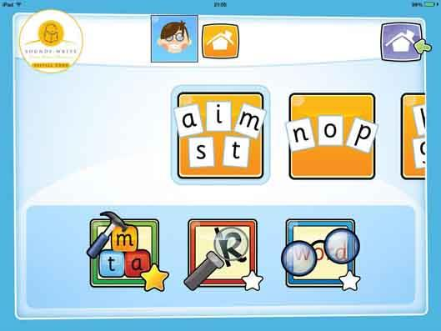
Useful Links
https://www.udemy.com/course/help-your-child-to-read-and-write/ Udemy SoundsWrite Course (free!)
SoundsWrite App

Slide 7
Symbol Search
Have the paper in front of your child. You say a sound and your child needs to find it and write over the top of it.
This helps with letter recognition and formation.
a | i | s
m | p | n
o | t | m

Slide 8
Sound Pairs
Have all the sounds face down on the table.
Take it in turns to turn over two cards. If the cards match you get another go. If they do not match it is your partners turn.
This helps with recognising sounds and memory games.

Slide 9
Word Bingo
In reception we need to read these everyday words:
is, a, the, I, for, of, are, was, all, come, some, to, there, their, these.
-Each child to have a bingo board. When the adult calls out the word put a counter on the word called.
-Don’t forget to shout bingo when all the words are covered.
This helps with recognising words and memory games.

Slide 10
Reading
Talk to your child about what is on the front page.
Q: What do you think the book might be about ?
Q: Who is the main character ?
Q: Can you open the book to the first page.
When reading a book with your child, they need to read the words (especially when it is a phonics book)
Make sure that your child is pointing to each word when they read.
At the end of the story check that your child knows what has happened in the story.
Q: What happened in the story ?
Q: How did they feel ?
Q: What do you think the main character should have done ?

Slide 11

Building and Blending
Can you put the right sound in the box ?
Choose a sound.
Sound out and blend the word.
Does it make sense ? Yes, well done. Now, try another one.
This helps with sounding, blending and phoneme manipulation.

Slide 12
a | m | t | i
s | p | n | o
a | m | t | i
s | p | n | o

Slide 13
 | a | was
the | for | of
is | a | was
 | for | of

Slide 14
is |  | was
the | for | of
is | a | was
the | for

Slide 15
is | a | was
the |  | of

