Slide 1
Welcome to Year 1 Family Learning

Slide 2
The focus today will primarily be on exploring our phonics program Sounds Write.

Slide 3
What is Sounds Write?
Sounds Write is a phonic rich program which focus' on teaching the 3 main skills required to successfully read and write. They are
* segmenting - c/ a / t
* blending
* phoneme manipulation
It is through repetition, exciting learning experiences, daily reading and writing that children in our school flourish as fluent readers and writers.

Slide 4
What does Sounds Write look like in a Year 1 classroom?
* A daily routine whereby all children explore lessons of word building, sounds swaps, reading and spelling of a focus sound that week for example /e/. We will demonstrate these for you shortly.
* In year one we dive into the digraphs for which the children know as 'two letters representing one sound'. For example the /ee/ in sleep
* A trigraph is 3 letters but one sound for example /igh/ in night.
The children learn that these digraphs and later trigraphs can be found in many words with multiple representations.

Slide 5
Same sound different spellings
* The children begin to learn that different spellings can represent the same sound for example the 'ee' in meet and the 'ea' in treat. We teach this by exposing the children to the sound through different spellings in a word building activity. We will teach you how to do this.

Slide 6
Word builder
This activity teaches the children to identify sounds in words and how they are built together through the skill of segementing.
We are going to build three words together.
When we teach through word building we encourage the children to use gestures to help segment the sounds in a word.

Slide 7
Same sound different spellings
Let’s have a go!

Slide 8
Sound Swap
Phoneme manipulation the skill of interchanging and swapping of sounds. Children learn sound and symbol correspondence through this activity. This is how a nonsense sound swap would be performed.

Slide 9
Same sound different spellings
Let’s have a go!

Slide 10
Seek the Sound
An activity such as seek the sound is used with an age level appropriate reading text that is full of words using a particular focus sound.
This activity is used once a new sound has been exposed through word building and children are to identify the multiple words by representing different spellings of that sound.

Slide 11
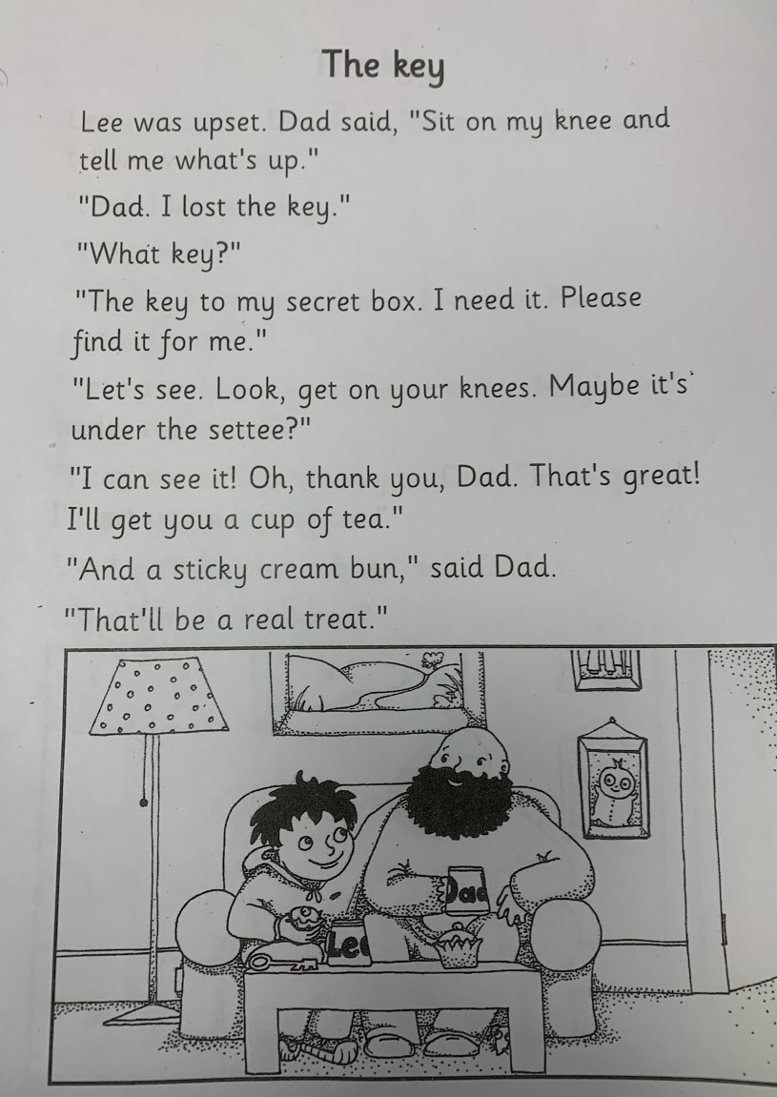

Slide 12
Top tips on practicing the spelling challenge words with your child at home
Tell
Tell your child the first word eg; feet
Ask
Ask your child to tell you the sounds they hear in the word feet eg; f/ee/t
Look
Look at the word together, underline the sounds you see as you read f/ee/t then blend the word together feet.
Go through
Go through the rest of the words in the same way.
Begin back
Begin back at the top of the list by saying the sounds as you write the words firstly by segmenting 'f/ee/t' then by blending 'feet.'
Repeat
Repeat this again the next afternoon in the same way so your child becomes comfortable reading, writing and saying the sounds of their word list.
Challenge
Now challenge them! Tell them the word without looking this time and they will say the sounds as they write.

Slide 13
How can you provide extra support your child at home?
When reading with your child its important that we try to use visuals to identify sounds instead of saying it’s the /e/ sound which is not the correct sound for that particular word or the letter e as this only leads to confusion. For example
Head -> the sounds would be /h/ /ea/ /d/ not /h/e/a/d.
If your ever stuck or unsure of a sound in a word a trick to remember is to cover up the word say the word out loud and think about the sounds you hear!
You are also encouraged to incorporate any of the demonstrated lessons shown into your home learning sessions or if that’s too much turn it into a fun game for example memory.

Slide 14
To live through these activities we are welcoming you to join in a carrousel type activity focusing on the sound e with the following representations.
/e/ /ee/ /ea/ /y/

Slide 15
Activities
1) Treasure or trash with words that are real or not real
2) Independent sorter
3) Learning spellings
4) Seek the sound

Slide 16
Parent support resources
Udemy course for parents of the initial code free download
Udemy course for parents of the extended code (£19.99)
Sounds write app for kids free download

Slide 17
Links
https://www.sounds-write.co.uk/page-82-app-for-ipad.aspx
https://www.udemy.com/course/help-your-child-to-read-and-write/

